Slide 1
Chapter 10
How to design a database

Slide 2
Objectives
Given the specifications for a database, identify the tables, columns, keys, relationships, and indexes for the database.
Given the tables for an unnormalized database, normalize the structure to the third normal form.
Use MySQL Workbench to create or work with an EER model for a database and any EER diagrams that are associated with that model.
Give three criteria for when a column should be indexed.
Describe referential integrity.
Explain how MySQL uses declarative referential integrity to prevent deletion, insertion, and update problems.
Explain how normalizing a database to the third normal form affects database performance.

Slide 3
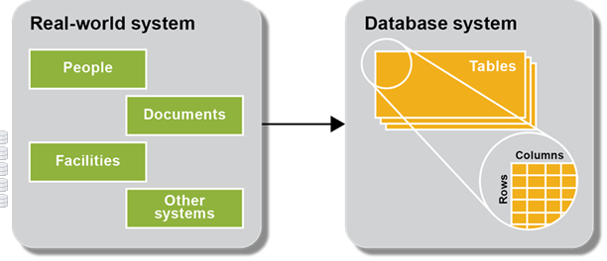
A database system is modeled after a real-world system
Real world entities are mapped to tables, columns, and rows of a database system
Each table represents an entity in the real word
Each column represents an attribute of the entity
Each row represents an instance of the entity
Well designed database is easy to understand and query, and modify as with well designed programs

Slide 4
The six basic steps for designing a data structure
Step 1: Identify the data elements
Step 2: Subdivide each element into its smallest useful components
Step 3: Identify the tables and assign columns
Step 4: Identify the primary and foreign keys, and relationships of tables
Step 5: Review whether the data structure is normalized
Step 6: Identify the indexes
ER modeling is used to model a database system
Good design requires good knowledge on the problem domain
Data structure, or Database structure is sometimes called database schema
Schema sometimes refer to the whole database

Slide 5
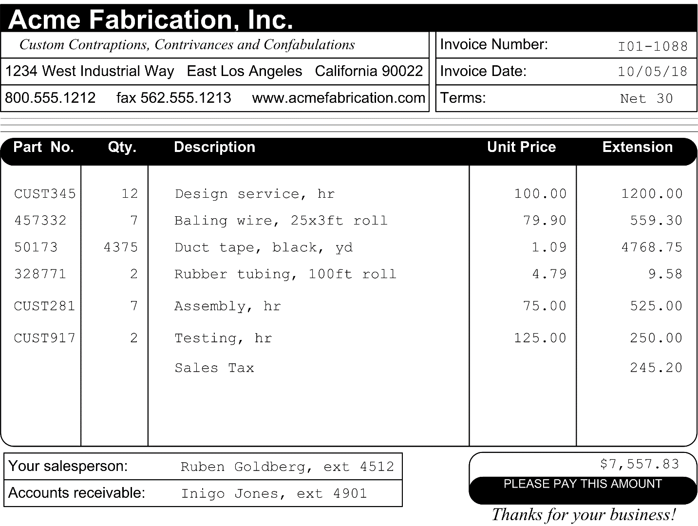
Invoice that’s used to identify data elements
This is an invoice you get from your vendor for items you purchased

Slide 6
Data elements?
Vendor name
Vendor address
Phone/fax number
Web address
Invoice number/date
Invoice terms
Item part number
Quantity
Description
Unit price
Item extension
Sales contact
Vendor AR contact
Invoice total

Slide 7
Data elements on the invoice document
Vendor name Item quantity
Vendor address Item description
Vendor phone number Item unit price
Vendor fax number Item extension
Vendor web address Vendor sales contact name
Invoice number Vendor sales contact extension
Invoice date Vendor AR contact name
Invoice terms Vendor AR contact extension
Item part number Invoice total

Slide 8
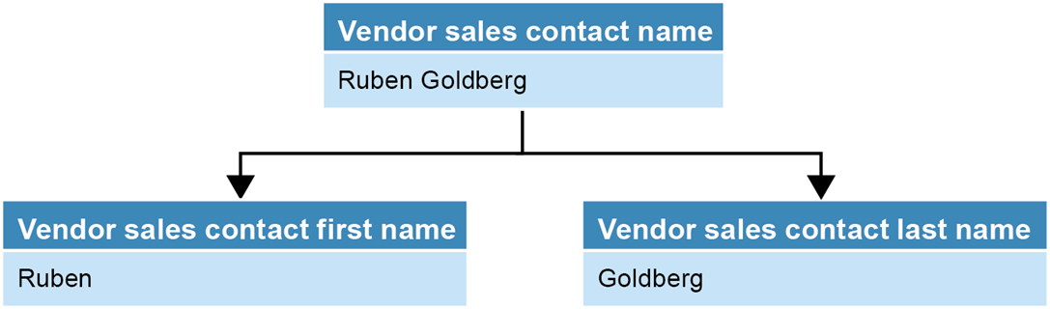
A name that’s divided into first and last names
Without dividing the name, you cannot easily sort names by last name or search by last name

Slide 9
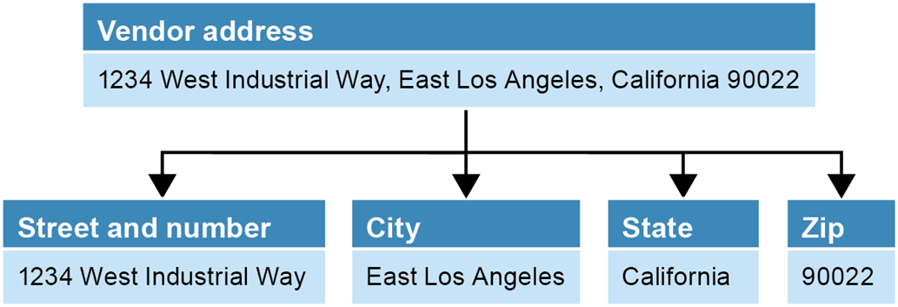
An address that’s divided into its components
Without dividing the address, you cannot sort the address by state, city, or zip code

Slide 10
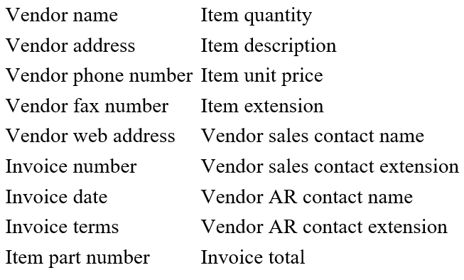
Possible tables and columns for an A/P system
It is easy to identify three main entities from the data elements
Put data elements into relevant entities. If not clear, data elements can belong to multiple table
Vendors Invoices Invoice line items
Vendor name Invoice number* Invoice number*
Vendor address Invoice date Item part number
Vendor city Invoice total Item quantity
Vendor state Item description
Vendor zip code Item unit price
Vendor phone number Item extension
Vendor fax number
Vendor web address
Vendor contact first name
Vendor contact last name
Vendor contact phone
Vendor AR first name
Vendor AR last name
Vendor AR phone
Note that data elements that are related to two or more entities are followed by an asterisk
You do this if you are not sure which table the data item belongs to

Slide 11
Possible tables and columns for an A/P system
Some data elements can be removed
Vendors Invoices Invoice line items
Vendor name Invoice number* Invoice number*
Vendor address Invoice date Item part number
Vendor city Invoice total Item quantity
Vendor state Item description
Vendor zip code Item unit price
Vendor phone number Item extension
Vendor fax number
Vendor web address
Vendor contact first name
Vendor contact last name
Vendor contact phone
Vendor AR first name
Vendor AR last name
Vendor AR phone
Vendor’s fax number and web address are not needed
Account Receivable data is removed

Slide 12
Possible tables and columns for an A/P system
Some new data can be added
Vendors Invoices Invoice line items
Vendor name Invoice number* Invoice number*
Vendor address Invoice date
Vendor city Terms* Item quantity
Vendor state Invoice total Item description
Vendor zip code Payment date Item unit price
Vendor phone number Payment total Item extension
Vendor contact first name Invoice due date Account number*
Vendor contact last name Credit total Sequence number
Terms*
Account number*
Data elements that were added later are displayed in italics.
Terms is for different payable terms
Within 10 days, 20 days, …
Terms is for each invoice and a default term is set for each vendor
Different account is used for different purposes

Slide 13
The notation for identifying data elements
Data elements that were previously identified but aren’t needed are crossed out.
Data elements that were added are displayed in italics.
Data elements that are related to two or more entities are followed by an asterisk.
These are just conventions used in this book

Slide 14
Finding Primary Keys
Vendors Invoices Invoice line items
Vendor name Invoice number* Invoice number*
Vendor address Invoice date
Vendor city Terms* Item quantity
Vendor state Invoice total Item description
Vendor zip code Payment date Item unit price
Vendor phone number Payment total Item extension
Vendor contact first name Invoice due date Account number*
Vendor contact last name Credit total Sequence number
Terms*
Account number*
The primary key for Vendors can be the vendor name. Problems?
The vendor name can be long and it may be easy to mistype
There can be multiple vendors with the same name
It would be better to have a new primary key, like vendor_id
The primary key can be multiple columns
The Invoice line items table’s primary key is (invoice#, seq #)
Invoice number can be a primary key for Invoices
The primary key should be easy to enter, and should not be long

Slide 15
Identifying Relationships
Vendors Invoices Invoice line items
Vendor name Invoice number* Invoice number*
Vendor address Invoice date
Vendor city Terms* Item quantity
Vendor state Invoice total Item description
Vendor zip code Payment date Item unit price
Vendor phone number Payment total Item extension
Vendor contact first name Invoice due date Account number*
Vendor contact last name Credit total Sequence number
Terms* Vendor_id*
Account number*
vendor_id*
Most relationships are one-many or many-one
Each vendor can have multiple invoices: one-many
Each invoice can have multiple items: one-many
Need to have a foreign key in the many part
The foreign key comes from the primary key of the one part
Add vendor_id to Invoices

Slide 16
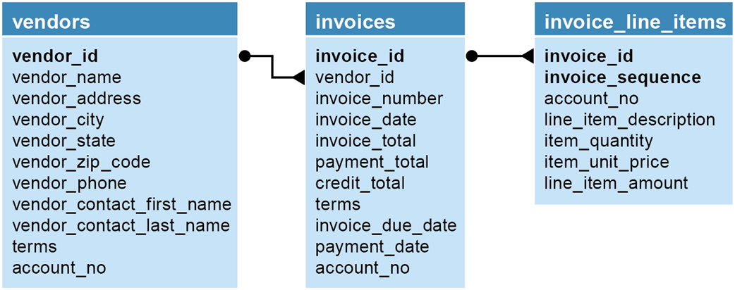
The relationships between the tables
Bold attributes are for primary keys
is for 1 to many relationships

Slide 17
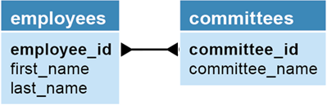
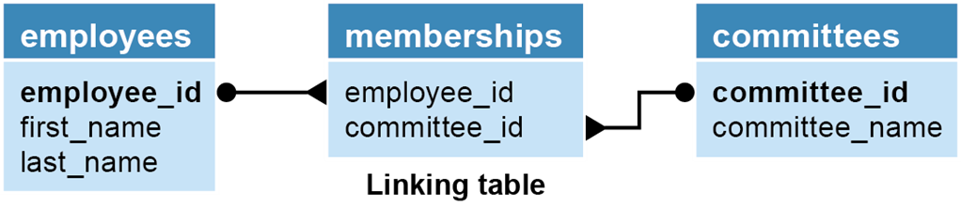
Tables with a many-to-many relationship
Relationships between Employees and Committees is many-many
In relational database, many-many relationships are converted to 1-many and many-1 relationship by adding a table in between
The table in the middle is called an association table or linking table
The association table has the primary key from both tables, each working as a foreign key
The association table can have its own attribute, then the composite foreign keys can work as its primary key

Slide 18
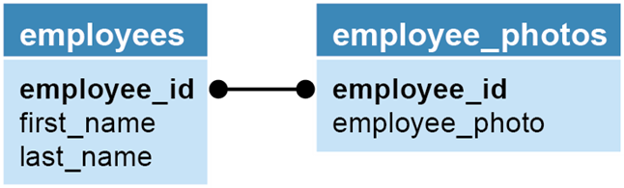
Two tables with a one-to-one relationship
Some 1-1 relationship can be merged into one table
If there are already too many columns in a table, or a column size is large (like photo images), splitting the table to two tables may enhance the performance
In such case, there are 1-1 relationships between the main table and split table
If photos are accessed rarely, it makes more sense to split
Note that the tables in one-one relationship have both the same primary key
What if we want to allow more than one employee photo?

Slide 19
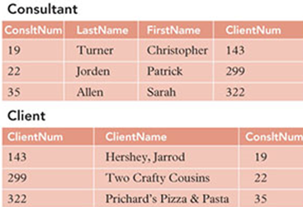
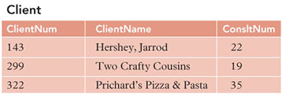
Example: one-to-one
Each client has a single consultant and each consultant represents a single client
Include the primary key of each table as a foreign key in the other table
No guarantee that the information will match after update
may create update anomalies and inconsistency in the database
ex)

Slide 20
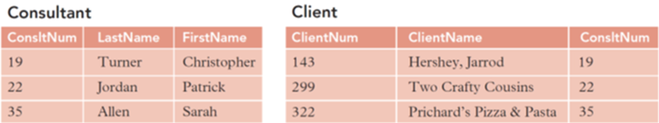
Example: one-to-one cont’d
Solution: Convert the one-one relationship to one-many
Note that this is one-many relationship
It is likely that one consultant may serve more than one client
The client can change its Consultant number as long as the consultant number exists in the Consultant table

Slide 21
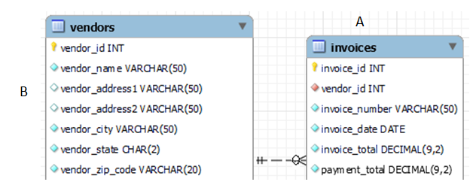
Referential Integrity
If table A contains a foreign key that matches the primary key of table B, the values of this foreign key must match the value of the primary key for some row in table B or be null
vendor_id from Invoices should match some of the vendor_ids in Vendors.

Slide 22
Violation of referential integrity
Deleting a row from the primary key table
If the foreign key table contains one or more rows related to the deleted row – the row in the foreign key table will be orphaned
Inserting a row in the foreign key table
If the foreign key value doesn’t have a matching primary key value in the related table
Updating the value of a foreign key
If the new foreign key value doesn’t have a matching primary key value in the related table
Updating the value of a primary key
If the foreign key table contains one or more rows related to the row that’s changed
In most RDBs, these violations will be detected automatically with foreign key declarations

Slide 23
Terms to know about table structures
Entity – table
Attribute – column
Instance – row
Entity-relationship (ER) modeling
Referential integrity
Declarative referential integrity (DRI)
Foreign key constraint
Orphaned row

Slide 24
Normalization
The process of structuring a database, usually a relational database, in accordance with a series of so-called normal forms in order to reduce data redundancy and improve data integrity.
Normalization process identifies potential problems or anomalies and correct them
Most widely used normal forms are 3NF and BCNF
To be in 3NF, a table has to be in 1NF and 2NF

Slide 25
Normalization
Problems can occur in un-normalized databases
To avoid problems, convert tables (or relations) to normalized forms
Update anomaly
Data inconsistency that results from data redundancy and a partial update
Insertion Anomaly
Inability to add a required piece of data due to absence of other data, or adding new rows may force user to create duplicate data
Deletion anomaly
Unintended loss of data due to deletion of other data

Slide 26
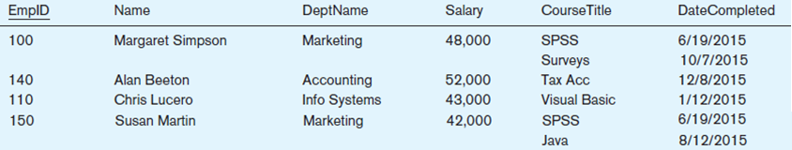
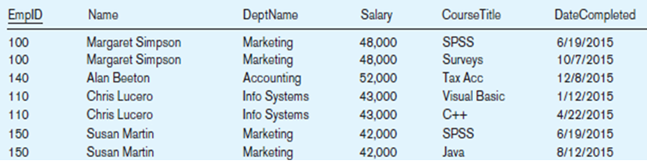
Example: Employee taking courses
Is this in first normal form?
No. There can’t be multiple items in a cell in 1NF
Is this in first normal form?

Slide 27
Example: Anomalies
Update
What happens if we raise the salary to employee 100?
You need to go through all employee instances with ID 100

Slide 28
Example: Anomalies
Insertion
Think about adding a new employee with ID 200
Cannot enter a new employee without having the employee taking a course
If the CorseTitle is a part of the primary key, it cannot be null

Slide 29
Example: Anomalies
Deletion
What happens if we remove employee 140?
We lose information about the existence of a Tax Acc class

Slide 30
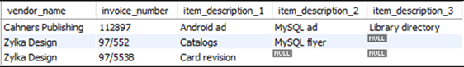
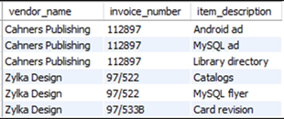
Two tables that need to be normalized
A table that contains repeating columns
An invoice can have multiple items
Some invoice may have a few and some other may have many
Waste of space
A table that contains redundant data
The vendor name and invoice numbers are repeated and they are redundant
Waste of space
Potential anomalies

Slide 31
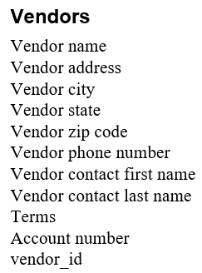
Identifying Relationships
Primary key: vendor_id
Dependencies
vendor_id → name, address, …, vendor contact names
Terms exist in both vendors and invoices, and it does not have much to do with either vendors or invoices
Provide a separate table for terms and provide descriptions
Account_number is for different kinds of account for payment and expenses, and has nothing to do with vendors
Provide a separate table for Account and provide descriptions

Slide 32
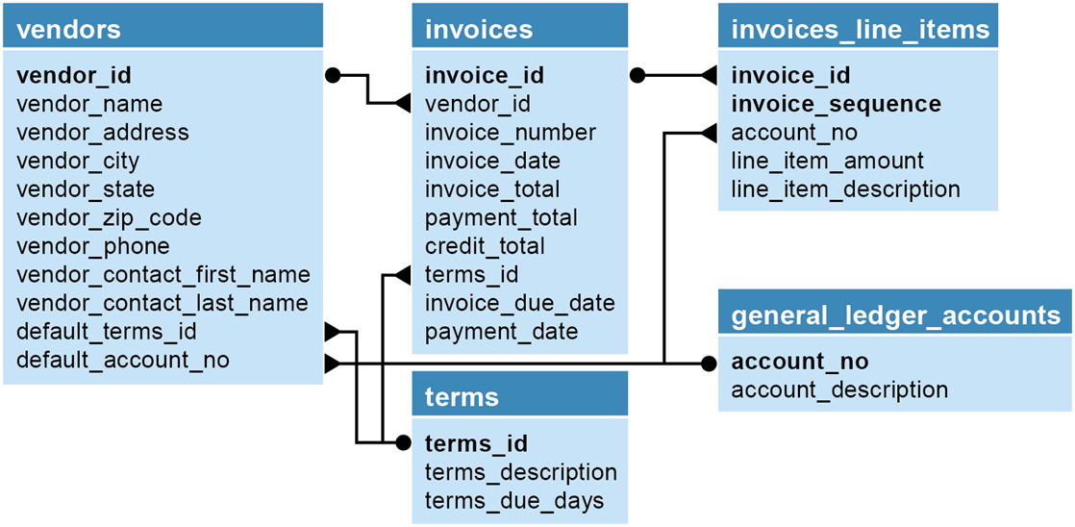
The accounts payable system in third normal form

Slide 33
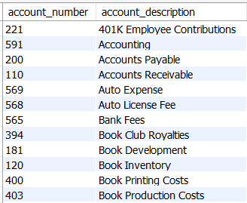
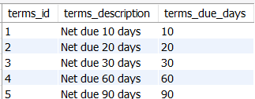
general_ledger_accounts
terms

Slide 34
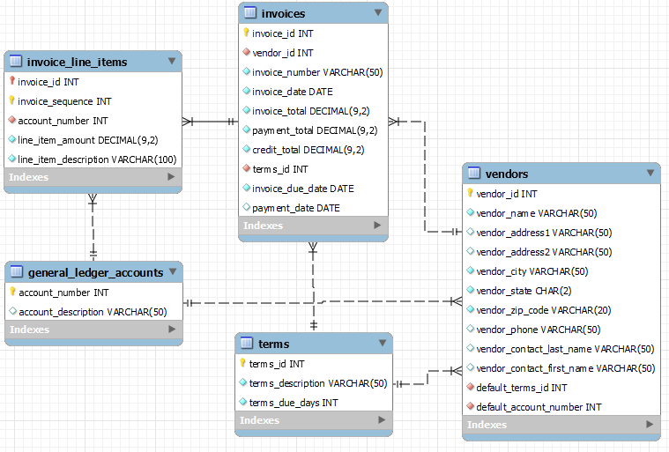
ER Diagram From WorkBench

Slide 35
Terms to know about normalizing a data structure
Normalization
Data redundancy
Unnormalized data structure
Normalized data structure
Normal forms

Slide 36
Creating an index
After a database tables are normalized, you want to decide columns need to be indexed
Most RDBs provide indexing for primary key and foreign key columns
How to identify the columns that need to be indexed?
When the column is used frequently in search conditions or joins
When the column contains a large number of distinct values
When the column is updated infrequently
Note that the primary keys and foreign keys seldom change

Slide 37
The first three normal forms
Normal form Description
First (1NF) The value stored at the intersection of each row and column must be a scalar value, and a table must not contain any repeating columns.
Second (2NF) Every non-key column must depend on the entire primary key.
There should be no partial dependency
Third (3NF) Every non-key column must depend only on the primary key.
There should be no transitive dependency.
Note
A table is called a relation if it is at least in 1NF
Most designers stop at 3NF or BCNF

Slide 38
The next four normal forms
Normal form Description
Boyce-Codd (BCNF) A non-key column can’t be dependent on another non-key column.
A relation is in BCNF, if and only if, every determinant is a candidate key.
Fourth (4NF) A table must not have more than one multivalued dependency, where the primary key has a one-to-many relationship to non-key columns.
Fifth (5NF) The data structure is split into smaller and smaller tables until all redundancy has been eliminated.
Domain-key (DKNF) Every constraint on the relationship is or dependent only on key constraints and Sixth (6NF) domain constraints, where a domain is the set of allowable values for a column.

Slide 39
The benefits of normalization
More tables, and each table has an index on its primary key. That makes data retrieval more efficient.
Each table contains information about a single entity. That makes data retrieval and insert, update, and delete operations more efficient.
Each table has fewer indexes, which makes insert, update, and delete operations more efficient.
Data redundancy is minimized, which simplifies maintenance and reduces storage.
So far, we went through ad hoc ways to normalize the Account Payable database
We will go through more formal normalization process

Slide 40
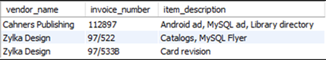
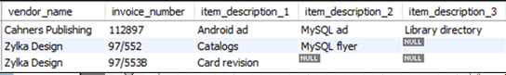
Unnormalized original invoice data
The invoice data with a column that contains repeating values
The invoice data with repeating columns
Waste of memory

Slide 41
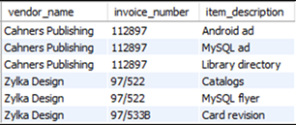
The invoice data in first normal form
By removing the repeating group, the table becomes 1NF
Primary key?
No single column or two columns in the above table can be a primary key
Add new primary key

Slide 42
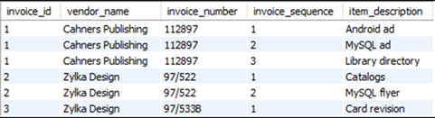
The invoice data in first normal form with keys added
The primary key is (invoice_id, invoice_sequence)
Note that the invoice_number column has values that are hard to enter or deal with, so we added a new column invoice_id
Note that invoice_id determines vendor_name and invoice_number – partial dependency
A table with partial dependency is not in 2NF
Remove the partial dependency by providing separate tables to make the table in 2NF

Slide 43
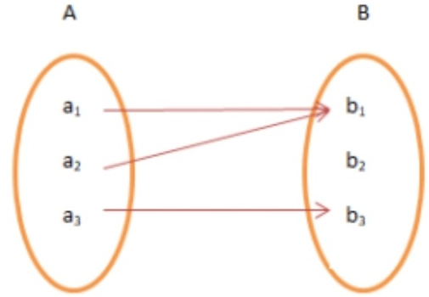
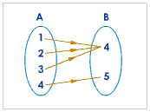
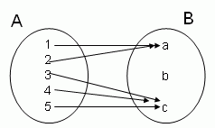
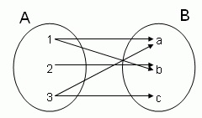
Functional Dependencies
Column B is functionally dependent on column A
Each value for A is associated with exactly one value of B:
A → B
A functionally determines B
Ex) A → B?

Slide 44

The primary key columns are underlined
The arrowed lines show the dependencies
The red lines show partial dependencies
Functional dependencies
Invoice_id, Invoice_seq → vendor_name, invoice_num, item_desc
Invoice_id → vendor_name, invoice_num
When the primary key is a single column, the table is automatically in 2NF
To achieve 2NF, remove partial dependences by providing separate tables
invoice_id | vendor_name | invoice_num | invoice_seq | item_desc
invoice_id | vendor_name | invoice_num
invoice_id | invoice_seq | item_desc

Slide 45
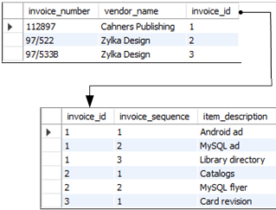
The invoice data: 1NF to 2NF
Invoices table
The primary key is invoice_id
Invoice_line_items table
The primary key is (invoice_id, invoice_sequence)
invoice_id in this table also works as a foreign key

Slide 46
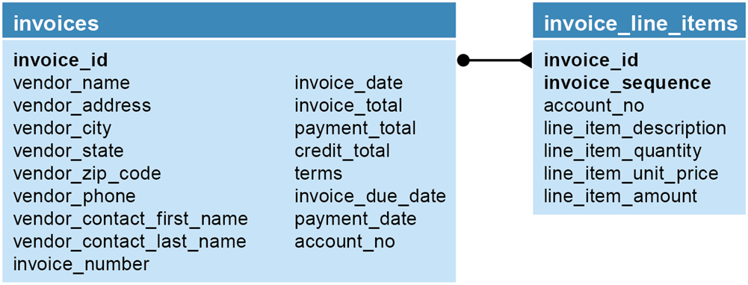
The A/P system in second normal form
Does the vendor information (vendor_name, vendor_address, etc.) depend on the invoice_id column? No
Provide vendor information in a separate table
Does the terms column depend on the invoice_id column? No
Terms is for each invoice and a default term is set for each vendor
Does the account_no column depend on the invoice_id column? No
Can the line_item_amount columns be derived from other data? yes

Slide 47
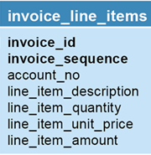
The A/P system in second normal form
For a table to be in third normal form, every non-key column must depend only on the primary key.
If a column doesn’t depend only on the primary key, it implies that the column is assigned to the wrong table or that it can be computed from other columns in the table.
Provide separate tables for Vendor, Terms, and Account
A column that can be computed from other columns contains derived data.
line_item_amount – can be obtained by multiplying item_quantity and item_unit_price, and it can be removed
Or, line_item_amount can be kept and item_quantity and item_unit_price can be removed

Slide 48
2NF to 3NF
2NF tables may still contain problems
Table (relation) is in 3NF if
It is in second normal form and
There is no transitive dependency
When we have C1 → C2 → C3, it is called a transitive dependency
Invoices table
Note that there are transitive dependencies
Needs a separate table for vendors
invoice_id | vendor_name | vendor_address | vendor_phone | …

Slide 49
After Normalization

Slide 50
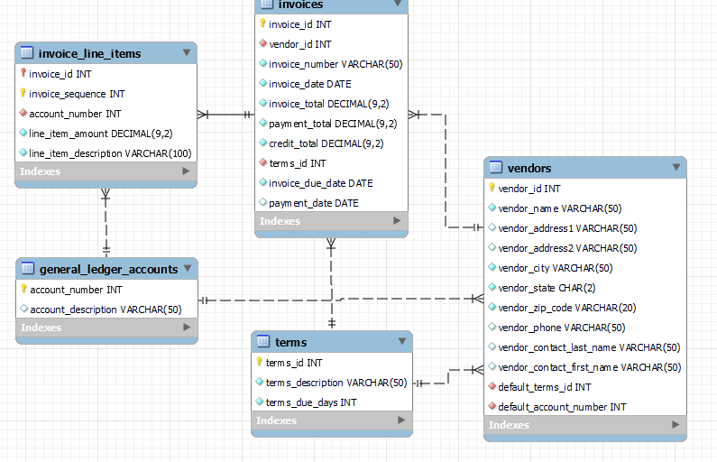
The A/P system in third normal form

Slide 51
Denormalization
Normalization does not concern about performance
Normalization focuses on removing redundancies and anomalies
If data is spread across multiple tables, it takes time to read them
Denomalization is the process of trying to improve the read performance of a database, at the expense of losing some write performance, by adding redundant copies of data
When to denormalize?
When a column from a joined table is used repeatedly in search criteria.
If a table is updated infrequently.
Include columns with derived values when those values are used frequently in search conditions

Slide 52
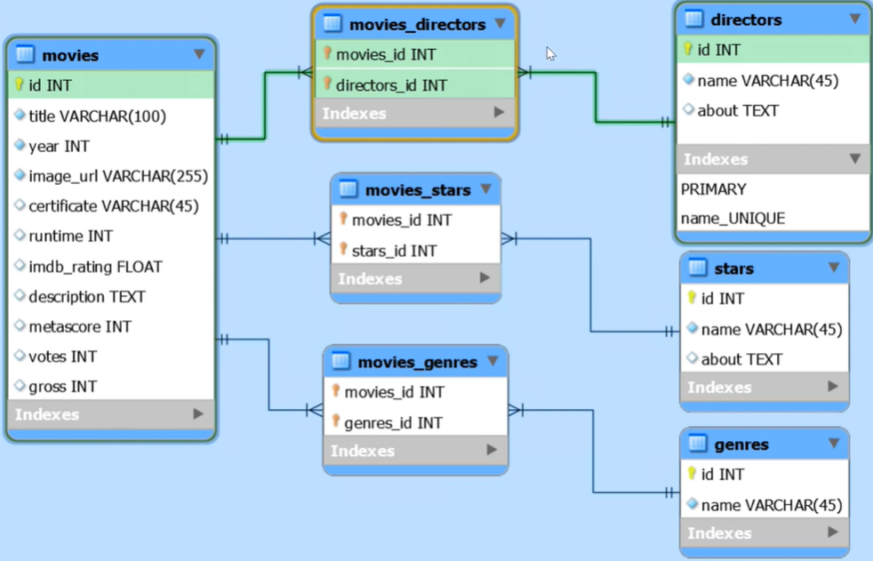
Homework
Using MySQL WorkBench modeling tool, create the following ER diagram for movies database

Slide 53
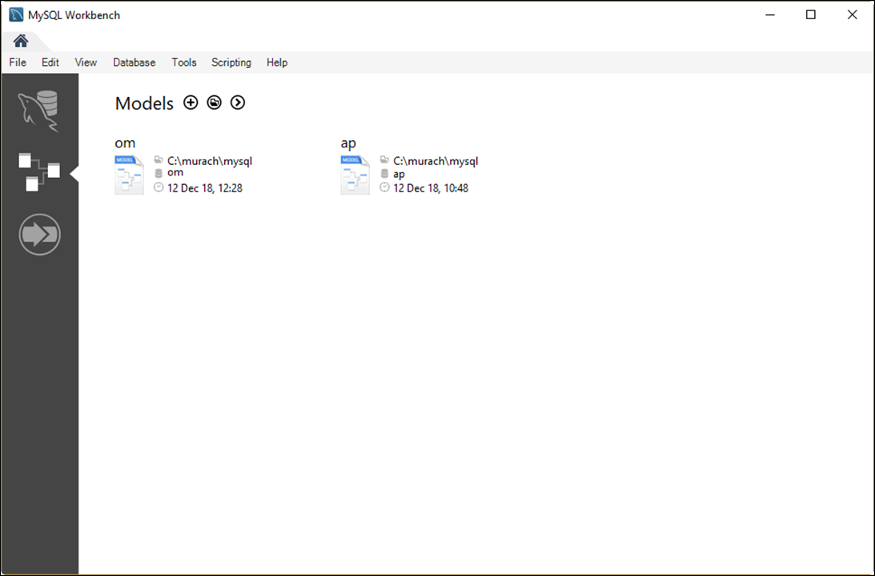
The Models tab of MySQL Workbench Home page
Select on models

Slide 54
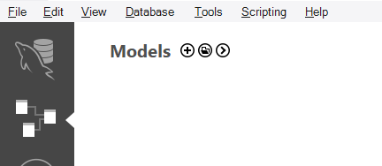
Operations you can perform from the Models tab
Open an existing EER model – click on
Create a blank EER model – click on
Create an EER model from an existing database – click on and select “Create EER Model from Database”
Create an EER model from a SQL creation script – click on and select “Create EER Model from Script”
Remove an EER model from the list

Slide 55
Operations for working with an EER model
Edit a table
Add a new table
Delete a table
Display a diagram
Create a new diagram
Create a database creation script from the model

Slide 56
Operations for working with an EER Diagram
Add an existing table to the diagram
Add a new table to the diagram
Display the model for a table
Define the relationship between two tables
Edit and delete relationships
Remove a table from the diagram (and, optionally, the model)

Slide 57
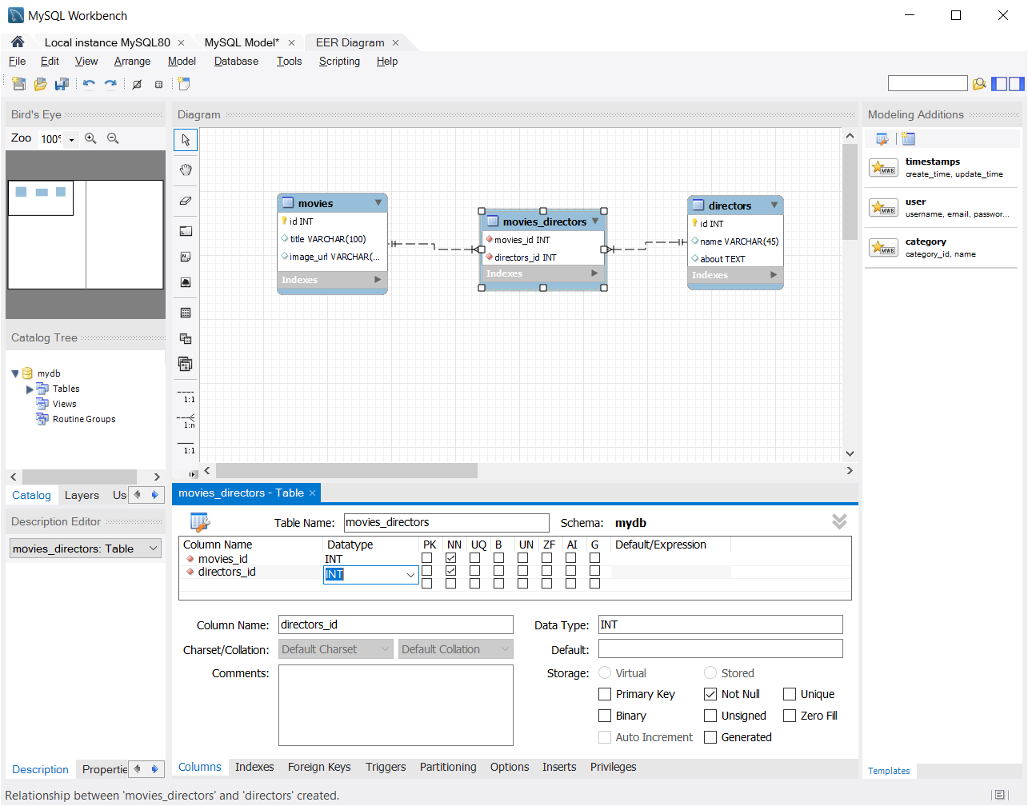
Example: EER model for the movies database

Slide 58
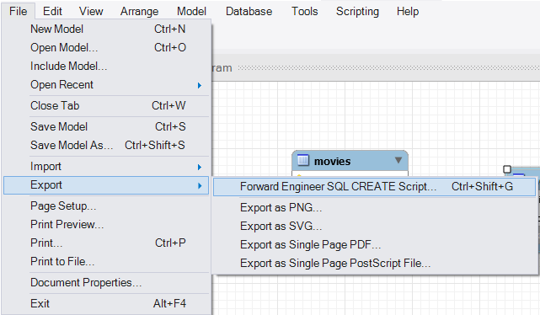
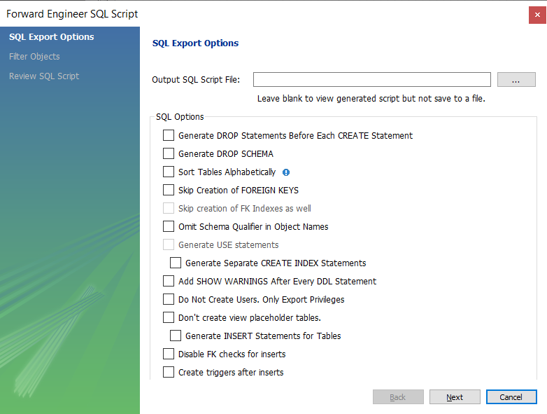
Creating SQL script from EER model
File → Export → Forward Engineer

Slide 59
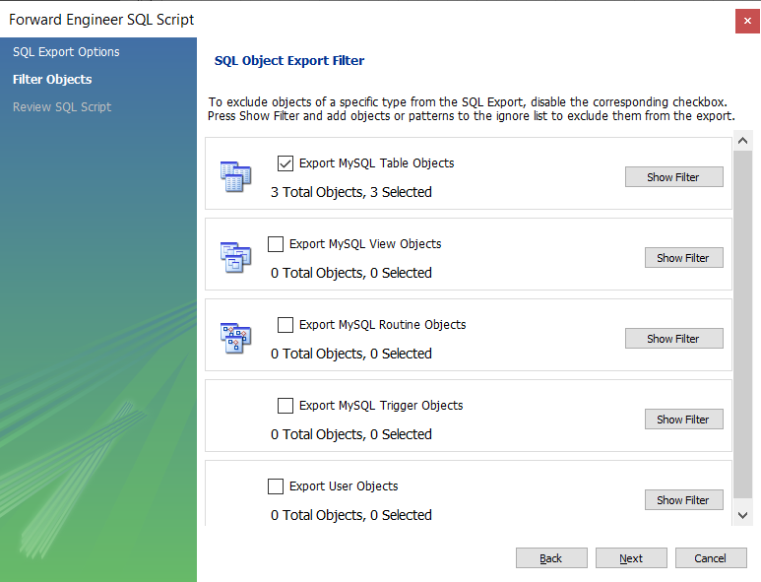
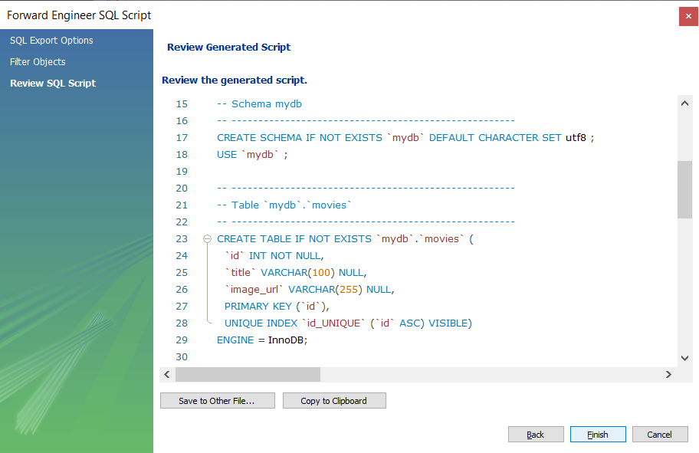

Slide 60
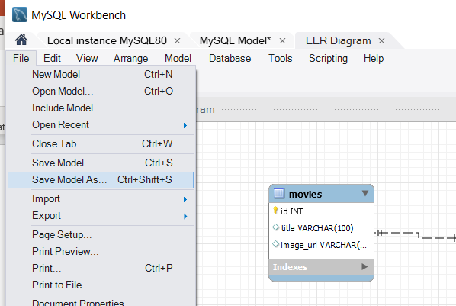
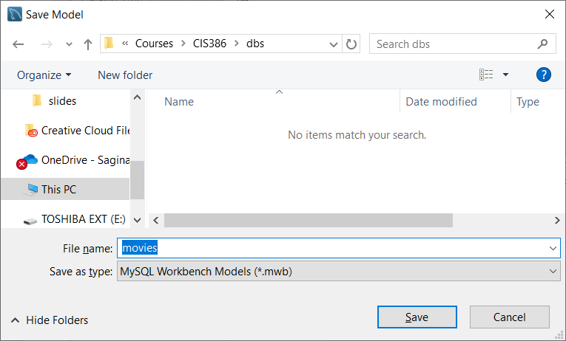

Saving Model

Slide 61
Chapter 11
How to create databases, tables, and indexes

Slide 62
Objectives
Given the design for a database, write the DDL (Data Definition Language) statements to create the tables, constraints, and indexes that are required.
Write a script that includes all of the DDL statements for creating the tables of a database.
Use MySQL Workbench to work with the columns, data, constraints, and indexes for a table.
Describe how each of these types of constraints restricts the values that can be stored in a table: not null, unique, primary key, and foreign key.
Describe the difference between a column-level constraint and a table-level constraint.
Describe the use of an index.
Describe the use of a script for creating the tables of a database.
Describe three character sets that are commonly used with MySQL and the pros and cons of each character set.
Describe how a collation works with a character set.
Describe two storage engines that are commonly used with MySQL and the pros and cons of each engine.

Slide 63
CREATE DATABASE statement
Syntax
CREATE DATABASE [IF NOT EXISTS] db_name
Attempt to create a database named AP
CREATE DATABASE ap
Create a database named AP only if it doesn’t exist
CREATE DATABASE IF NOT EXISTS ap

Slide 64
DROP DATABASE statement
Syntax
DROP DATABASE [IF EXISTS] db_name
Attempt to drop a database named AP
DROP DATABASE ap
Drop a database named AP only if it exists
DROP DATABASE IF EXISTS ap

Slide 65
USE statement
Syntax
USE db_name
Select a database named AP
USE ap

Slide 66
CREATE TABLE statement
CREATE TABLE [db_name.]table_name
(
column_name_1 data_type [column_attributes]
[, column_name_2 data_type [column_attributes]]...
[, table_level_constraints]
)
Common column attributes
NOT NULL
UNIQUE
DEFAULT default_value
AUTO_INCREMENT

Slide 67
A statement that creates a table without column attributes
CREATE TABLE vendors
(
vendor_id INT,
vendor_name VARCHAR(50)
)
With column attributes
CREATE TABLE vendors
(
vendor_id INT NOT NULL UNIQUE AUTO_INCREMENT,
vendor_name VARCHAR(50) NOT NULL UNIQUE
)

Slide 68
Another statement that creates a table with column attributes
CREATE TABLE invoices
(
invoice_id INT NOT NULL UNIQUE,
vendor_id INT NOT NULL,
invoice_number VARCHAR(50) NOT NULL,
invoice_date DATE,
invoice_total DECIMAL(9,2) NOT NULL,
payment_total DECIMAL(9,2) DEFAULT 0
)

Slide 69
The syntax of a column-level primary key constraint
column_name data_type PRIMARY KEY col_attributes
A table with column-level constraints
CREATE TABLE vendors
(
vendor_id INT PRIMARY KEY AUTO_INCREMENT,
vendor_name VARCHAR(50) NOT NULL UNIQUE
)

Slide 70
The syntax of a table-level primary key constraint
[CONSTRAINT [constraint_name]]
PRIMARY KEY (column_name_1[, column_name_2]...)
A table with table-level constraints
CREATE TABLE vendors
(
vendor_id INT AUTO_INCREMENT,
vendor_name VARCHAR(50) NOT NULL,
CONSTRAINT vendors_pk PRIMARY KEY (vendor_id),
CONSTRAINT vendor_name_uq UNIQUE (vendor_name)
)

Slide 71
A table with a two-column primary key constraint
CREATE TABLE invoice_line_items
(
invoice_id INT NOT NULL,
invoice_sequence INT NOT NULL,
line_item_description VARCHAR(100) NOT NULL,
CONSTRAINT line_items_pk
PRIMARY KEY (invoice_id, invoice_sequence)
)

Slide 72
Column-level foreign key constraint
REFERENCES table_name (column_name)
[ON DELETE {CASCADE|SET NULL}]
A table with a column-level foreign key constraint
CREATE TABLE invoices
(
invoice_id INT PRIMARY KEY,
vendor_id INT REFERENCES vendors (vendor_id),
invoice_number VARCHAR(50) NOT NULL UNIQUE
)

Slide 73
Table-level foreign key constraint
[CONSTRAINT constraint_name]
FOREIGN KEY (column_name_1[, column_name_2]...)
REFERENCES table_name (column_name_1
[, column_name_2]...)
[ON DELETE {CASCADE|SET NULL}]
A table with a table-level foreign key constraint
CREATE TABLE invoices
(
invoice_id INT PRIMARY KEY,
vendor_id INT NOT NULL,
invoice_number VARCHAR(50) NOT NULL UNIQUE,
CONSTRAINT invoices_fk_vendors
FOREIGN KEY (vendor_id)
REFERENCES vendors (vendor_id)
)

Slide 74
An INSERT statement that fails because a related row doesn’t exist
INSERT INTO invoices
VALUES (1, 1, '1') -- assume that vendor id 1 does not exist
The response from the system
Error Code: 1452. Cannot add or update a child row: a foreign key constraint fails ('ex'.'invoices', CONSTRAINT 'invoices_fk_vendors' FOREIGN KEY ('vendor_id') REFERENCES 'vendors' ('vendor_id'))
CREATE TABLE invoices
(
invoice_id INT PRIMARY KEY,
vendor_id INT NOT NULL,
invoice_number VARCHAR(50) NOT NULL UNIQUE,
CONSTRAINT invoices_fk_vendors
FOREIGN KEY (vendor_id)
REFERENCES vendors (vendor_id)
)

Slide 75
Constraint that uses ON DELETE
CREATE TABLE invoices (
...
CONSTRAINT invoices_fk_vendors
FOREIGN KEY (vendor_id) REFERENCES vendors (vendor_id)
ON DELETE CASCADE
)
If a row in vendors is deleted, it will delete rows from the invoices table that matches the vendor id

Slide 76
Foreign key Constraints
FOREIGN KEY (col_name, ...)
REFERENCES tbl_name (col_name,...)
[ON DELETE reference_option]
[ON UPDATE reference_option]
reference_option:
RESTRICT | CASCADE | SET NULL | NO ACTION

Slide 77
Constraints for ON UPDATE/DELETE
On Update/Delete Restrict
Any update/delete made to the Customer table that would delete or change a primary key value will be rejected if a foreign key references that value in the Order table.
Same as omitting On Update or Delete.
Same as No Action.
On Update/Delete Cascade
Any update/delete made to the Customer table should be cascaded through to the Order table.
On Update/Delete Set Null
Any values that are updated/deleted in the Customer table cause affected columns in the Order table to be set to null.

Slide 78
Terms to know about constraints
Column-level constraint
Table-level constraint
Not null constraint
Unique constraint
Primary key constraint
Foreign key constraint

Slide 79
Modifying the columns of a table
After you create tables, you can add, modify, or drop a column.
ALTER TABLE [db_name.]table_name
{
ADD column_name data_type [column_attributes] |
DROP COLUMN column_name |
MODIFY column_name data_type [column_attributes] |
RENAME COLUMN old_column_name TO new_column_name
}

Slide 80
A statement that adds a new column
ALTER TABLE vendors
ADD last_transaction_date DATE
A statement that drops a column
ALTER TABLE vendors
DROP COLUMN last_transaction_date

Slide 81
A statement that changes the length of a column
ALTER TABLE vendors
MODIFY vendor_name VARCHAR(100) NOT NULL
A statement that changes the type of a column
ALTER TABLE vendors
MODIFY vendor_name CHAR(100) NOT NULL
A statement that changes the default value
ALTER TABLE vendors
MODIFY vendor_name VARCHAR(100) NOT NULL
DEFAULT 'New Vendor’
The new data type can be bigger, but not smaller
For example, changing from VARCHAR(50) to VARCHAR(100) is OK, but not the other way around
The original vendor_name had NOT NULL attribute. Without it, the NOT NULL attribute will be dropped from the modified vendor_name

Slide 82
A statement that changes the name of a column
ALTER TABLE vendors
RENAME COLUMN vendor_name TO v_name
A statement that fails because it would lose data
ALTER TABLE vendors
MODIFY v_name VARCHAR(10) NOT NULL
The response from the system
Error Code: 1265. Data truncated for column 'v_name' at row 1
MySQL won’t allow you to change a column if that change would cause data to be lost.

Slide 83
The syntax for modifying the constraints of a table
ALTER TABLE [dbname.]table_name
{
ADD [CONSTRAINT constraint_name]
PRIMARY KEY constraint_definition |
ADD [CONSTRAINT constraint_name]
FOREIGN KEY constraint_definition |
DROP PRIMARY KEY |
DROP FOREIGN KEY constraint_name
}

Slide 84
A statement that adds a primary key constraint
ALTER TABLE vendors
ADD PRIMARY KEY (vendor_id)
A statement that adds a foreign key constraint
ALTER TABLE invoices
ADD CONSTRAINT invoices_fk_vendors
FOREIGN KEY (vendor_id) REFERENCES vendors (vendor_id)

Slide 85
A statement that drops a primary key constraint
ALTER TABLE vendors
DROP PRIMARY KEY
A statement that drops a foreign key constraint
ALTER TABLE invoices
DROP FOREIGN KEY invoices_fk_vendors
MySQL won’t allow you to delete the primary key if the primary key is an auto increment column or if it’s referred to by foreign keys.
Since most primary keys are referred to by at least one foreign key, you can’t typically delete a primary key
Because a table can contain more than one foreign key, you must specify the name of the key to drop

Slide 86
A statement that renames a table
RENAME TABLE vendors TO vendor
A statement that deletes all data from a table
TRUNCATE TABLE vendor
A statement that deletes a table from the current database
DROP TABLE vendor
If you rename a table, you should probably update the names of any constraints that use the name of the table. To do that, you have to drop the constraint and then add it back.
With DROP, both the table definition and the data in the table are removed

Slide 87
A statement that qualifies the table to be deleted
DROP TABLE ex.vendor
A statement that returns an error due to a foreign key reference
DROP TABLE vendors
The response from the system
Error Code: 3730. Cannot drop table 'vendors' referenced by a foreign key constraint 'invoices_fk_vendors' on table 'invoices'
A table cannot be dropped if there is another table that depends on it
The invoices table depend on the vendors table
To drop the vendors table, first drop the invoices table

Slide 88
CREATE INDEX statement
CREATE [UNIQUE] INDEX index_name
ON [dbname.]table_name (col_name_1 [ASC|DESC][,
col_name_2 [ASC|DESC]]...)
Use the UNIQUE keyword if the index contains only the unique values
A statement that creates an index based on a single column
CREATE INDEX invoices_invoice_date_ix
ON invoices (invoice_date)
Index based on two columns
CREATE INDEX invoices_vendor_id_invoice_number_ix
ON invoices (vendor_id, invoice_number)
Note the naming convention. if the table or column names are lengthy, you can abbreviate their names

Slide 89
A statement that creates a unique index
CREATE UNIQUE INDEX vendors_vendor_phone_ix
ON vendors (vendor_phone)
A statement that creates an index that’s sorted in descending order
CREATE INDEX invoices_invoice_total_ix
ON invoices (invoice_total DESC)
A statement that drops an index
DROP INDEX vendors_vendor_phone_ix ON vendors
You may want to drop an index if you suspect that it isn’t speeding up your joins and searches and that it may be slowing down your insert, update, and delete operations

Slide 90
The script that creates the AP database
-- create the database
DROP DATABASE IF EXISTS ap;
CREATE DATABASE ap;
-- select the database
USE ap;
-- create the tables
CREATE TABLE general_ledger_accounts
(
account_number INT PRIMARY KEY,
account_description VARCHAR(50) UNIQUE
);
CREATE TABLE terms
(
terms_id INT PRIMARY KEY
AUTO_INCREMENT,
terms_description VARCHAR(50) NOT NULL,
terms_due_days INT NOT NULL
);
When you create tables, you must create the tables that don’t have foreign keys first.
When you drop tables, you must drop the last table that was created first

Slide 91
Storage engines
A storage engine determines how MySQL stores data and which database features are available to you.
MySQL provides several different storage engines
Commonly used storage engines
InnoDB – default
MyISAM

Slide 92
Chapter 11
How to create databases, tables, and indexes

Slide 93
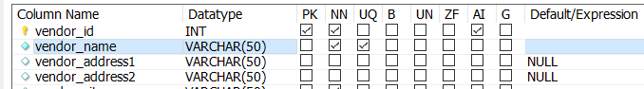
Example: Insertion fails due to unique name
INSERT INTO vendors VALUES
(200,'US Postal Service', 'Attn: Supt. Window Services','PO Box 7005','Madison','WI','53707','(800) 555-1205','Alberto','Francesco',1,552)
10:38:57 INSERT INTO vendors VALUES (200,'US Postal Service','Attn: Supt. Window Services','PO Box 7005','Madison','WI','53707','(800) 555-1205','Alberto','Francesco',10,552)
Error Code: 1062. Duplicate entry 'US Postal Service' for key 'vendors.vendor_name' 0.000 sec
Venders table: vendor name should be unique

Slide 94
Foreign key constraints
CREATE TABLE invoices (
...
CONSTRAINT invoices_fk_vendors
FOREIGN KEY (vendor_id) REFERENCES vendors (vendor_id)
...
)
ON DELETE RESTRICT is default

Slide 95
Foreign key Constraints
FOREIGN KEY (col_name, ...)
REFERENCES tbl_name (col_name,...)
[ON DELETE reference_option]
[ON UPDATE reference_option]
reference_option:
RESTRICT | CASCADE | SET NULL | NO ACTION

Slide 96
Constraints for ON UPDATE/DELETE
On Update/Delete Restrict
Any update/delete made to the Customer table that would delete or change a primary key value will be rejected if a foreign key references that value in the Order table.
Same as omitting On Update or Delete.
Same as No Action.
On Update/Delete Cascade
Any update/delete made to the Customer table should be cascaded through to the Order table.
On Update/Delete Set Null
Any values that are updated/deleted in the Customer table cause affected columns in the Order table to be set to null.

Slide 97
Constraint that uses ON DELETE
CREATE TABLE invoices (
...
CONSTRAINT invoices_fk_vendors
FOREIGN KEY (vendor_id) REFERENCES vendors (vendor_id) ON DELETE CASCADE
...
)
If a row in vendors is deleted, it will delete rows from the invoices table that matches the vendor id

Slide 98
Chapter 12
How to create views

Slide 99
Objectives
Create and use views, including read-only and updatable views.
Describe a view.
Describe the benefits of using views.
Given a view, determine whether it is updatable.
Describe the effect of the WITH CHECK OPTION clause on an updatable view.

Slide 100
Views
Virtual tables
Application program’s or individual user’s picture of the database
Dynamically created
Advantages over tables
A view can limit the degree of exposure of the underlying tables to the outer world
Views can join and simplify multiple tables into a single virtual table.
Views can hide the complexity of data.
Views can provide extra security.

Slide 101
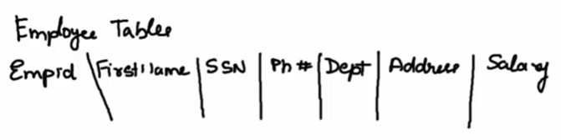
Views: Example
Normal users should not have an access to SSN and Salary
Tax department may need information on SSN and Salary
→ Create two views from the base table, one for normal users and another for the tax department

Slide 102
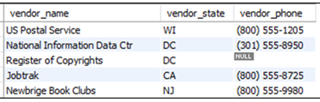
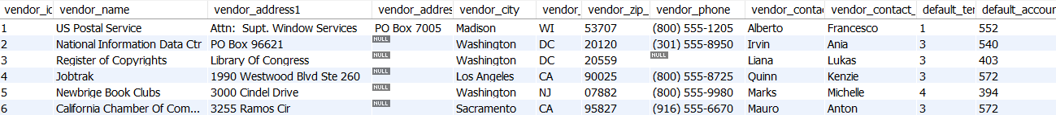
A CREATE VIEW statement
CREATE VIEW vendors_min AS
SELECT vendor_name, vendor_state, vendor_phone
FROM vendors
The virtual table that’s represented by the view
Full table

Slide 103
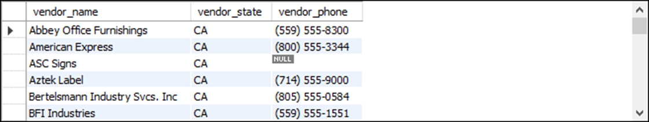
A SELECT statement that uses the view
SELECT * FROM vendors_min
WHERE vendor_state = 'CA'
ORDER BY vendor_name
The result set returned by the SELECT statement

Slide 104
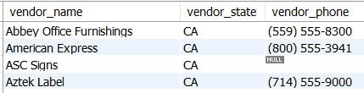
An UPDATE statement that uses the view to update the base table
UPDATE vendors_min
SET vendor_phone = '(800) 555-3941'
WHERE vendor_name = 'American Express’
A statement that drops the view
DROP VIEW vendors_min

Slide 105
View
When you create a view, you can refer to the view anywhere you would normally use a table in a SELECT, INSERT, UPDATE, or DELETE statement.
Although a view behaves like a virtual table, it doesn’t store any data. Instead, a view always refers back to its base tables.

Slide 106
Some of the benefits provided by views
Design independence
Views can limit the exposure of tables to external users and applications.
As a result, if the design of the tables changes, you can modify the view as necessary so users who query the view don’t need to be aware of the change, and applications that use the view don’t need to be modified.
Data security
Simplified queries
Views can be used to hide the complexity of retrieval operations. Then, the data can be retrieved using simple SELECT statements that specify a view in the FROM clause.
Updatability
With certain restrictions, views can be used to update, insert, and delete data from a base table

Slide 107

The syntax of the CREATE VIEW statement
CREATE [OR REPLACE] VIEW view_name
[(column_alias_1[, column_alias_2]...)]
AS
select_statement
[WITH CHECK OPTION]
A view of vendors that have invoices
CREATE VIEW vendors_phone_list AS
SELECT vendor_name, vendor_contact_last_name,
vendor_contact_first_name, vendor_phone
FROM vendors
WHERE vendor_id IN
(SELECT DISTINCT vendor_id FROM invoices)
Select * from vendors_phone_list;

Slide 108

A view that uses a join
CREATE OR REPLACE VIEW vendor_invoices AS
SELECT vendor_name, invoice_number, invoice_date,
invoice_total
FROM vendors JOIN invoices
ON vendors.vendor_id = invoices.vendor_id
When you code a CREATE VIEW statement, you can specify that you want to automatically drop a view that has the same name as the view that you’re creating.
To do that, you can specify the OR REPLACE
Select * from vendor_invoices;

Slide 109

A view that uses a LIMIT clause
CREATE OR REPLACE VIEW top5_invoice_totals AS
SELECT vendor_id, invoice_total
FROM invoices
ORDER BY invoice_total DESC
LIMIT 5;
Select * from top5_invoice_totals;

Slide 110

A view that names all of its columns in the CREATE VIEW clause
CREATE OR REPLACE VIEW invoices_outstanding
(invoice_number, invoice_date, invoice_total,
balance_due)
AS
SELECT invoice_number, invoice_date, invoice_total,
invoice_total - payment_total - credit_total
FROM invoices
WHERE invoice_total - payment_total - credit_total > 0;

Slide 111
A view that names just the calculated column in its SELECT clause
CREATE OR REPLACE VIEW invoices_outstanding AS
SELECT invoice_number, invoice_date, invoice_total,
invoice_total - payment_total - credit_total
AS balance_due
FROM invoices
WHERE invoice_total - payment_total - credit_total > 0;
Same result

Slide 112

A view that summarizes invoices by vendor
CREATE OR REPLACE VIEW invoice_summary AS
SELECT vendor_name,
COUNT(*) AS invoice_count,
SUM(invoice_total) AS invoice_total_sum
FROM vendors JOIN invoices
ON vendors.vendor_id = invoices.vendor_id
GROUP BY vendor_name;

Slide 113
Updatable views
You can use INSERT, UPDATE, and DELETE statements on the view to modify the data that’s stored in an underlying table
Requirements fore creating updatable views
The select list can’t include a DISTINCT clause.
The select list can’t include aggregate functions.
The SELECT statement can’t include a GROUP BY or HAVING clause.
The view can’t include the UNION operator.
You can’t update any calculated columns that are used by the view

Slide 114
A CREATE VIEW statement that creates an updatable view
CREATE OR REPLACE VIEW balance_due_view AS
SELECT vendor_name, invoice_number,
invoice_total, payment_total, credit_total,
invoice_total - payment_total - credit_total
AS balance_due
FROM vendors JOIN invoices
ON vendors.vendor_id = invoices.vendor_id
WHERE invoice_total - payment_total - credit_total > 0
An UPDATE statement that uses the view
UPDATE balance_due_view
SET credit_total = 300
WHERE invoice_number = '9982771'
The response from the system
(1 row affected)

Slide 115
An updatable view that has a WITH CHECK OPTION clause
Prevents an update if it causes the row to be excluded from the view.
CREATE OR REPLACE VIEW vendor_payment AS
SELECT vendor_name, invoice_number, invoice_date,
payment_date, invoice_total, credit_total,
payment_total
FROM vendors JOIN invoices
ON vendors.vendor_id = invoices.vendor_id
WHERE invoice_total - payment_total - credit_total >= 0
WITH CHECK OPTION
If you use WITH CHECK OPTION…
An error will occur if you try to modify a row so it’s no longer included in the view.

Slide 116
A SELECT statement that displays a row from the view
SELECT * FROM vendor_payment
WHERE invoice_number = 'P-0608'
The result set

Slide 117
A DELETE statement that fails due to a foreign key constraint
DELETE FROM ibm_invoices
WHERE invoice_number = 'Q545443'
The response from the system
Error Code: 1451. Cannot delete or update a parent row: a foreign key constraint fails ('ap'.'invoice_line_items', CONSTRAINT 'line_items_fk_invoices' FOREIGN KEY ('invoice_id') REFERENCES 'invoices' ('invoice_id'))
The Invoice_Line_Items table contains rows related to the invoice
To get this DELETE statement to work, you must first delete the related line items for the invoice

Slide 118
Two DELETE statements that succeed
DELETE FROM invoice_line_items
WHERE invoice_id = (SELECT invoice_id FROM invoices
WHERE invoice_number = 'Q545443');
DELETE FROM ibm_invoices
WHERE invoice_number = 'Q545443';
The response from the system
(1 row affected)

Slide 119
Alerting a view
Can be done using either
ALTER VIEW view_name
or
CREATE OR REPLACE VIEW view_name
A statement that creates a view
CREATE VIEW vendors_sw AS
SELECT * FROM vendors
WHERE vendor_state IN ('CA','AZ','NV','NM')
A statement that replaces the view with a new view
CREATE OR REPLACE VIEW vendors_sw AS
SELECT * FROM vendors
WHERE vendor_state IN ('CA','AZ','NV','NM','UT','CO')
A statement that drops the view
DROP VIEW vendors_sw

Slide 120
Chapter 13
Language skills for writing stored programs

Slide 121
Objectives
Applied
Write a script that creates and calls a stored procedure that can be used to test MySQL’s language features.
Use MySQL to write procedural code that uses IF statements, CASE statements, loops, cursors, and condition handlers.

Slide 122
Objectives (continued)
Knowledge
Distinguish between stored procedures, stored functions, triggers, and events.
Distinguish between the IF, CASE, WHILE, REPEAT, DECLARE CURSOR, and DECLARE…HANDLER statements.
Describe how a loop can be used to work with a cursor.
Distinguish between a simple CASE statement and a searched CASE statement.
Distinguish between a CONTINUE handler and an EXIT handler.

Slide 123
Four types of stored programs
Stored procedure
Stored function
Trigger
Event

Slide 124
Stored procedure
Format:
DELIMITER //
CREATE PROCEDURE ProcName()
BEGIN
...
END //
DELIMITER ;
To invoke:
CALL ProcName();

Slide 125
A script that creates and calls a stored procedure
USE ap;
DROP PROCEDURE IF EXISTS test;
-- Change statement delimiter from semicolon to double front slash
DELIMITER //
CREATE PROCEDURE test()
BEGIN
DECLARE sum_balance_due_var DECIMAL(9, 2);
SELECT SUM(invoice_total - payment_total - credit_total)
INTO sum_balance_due_var
FROM invoices
WHERE vendor_id = 95;

Slide 126

A script that creates and calls a stored procedure (continued)
IF sum_balance_due_var > 0 THEN
SELECT CONCAT('Balance due: $', sum_balance_due_var) AS message;
ELSE
SELECT 'Balance paid in full' AS message;
END IF;
END//
-- Change statement delimiter from double front slash to semicolon
DELIMITER ;
CALL test();
The response from the system

Slide 127
SQL statements for controlling the flow of execution
IF...ELSEIF...ELSE
CASE...WHEN...ELSE
WHILE...DO...LOOP
REPEAT...UNTIL...END REPEAT
DECLARE CURSOR FOR
DECLARE...HANDLER

Slide 128


A stored procedure that displays a message
DELIMITER //
CREATE PROCEDURE test()
BEGIN
SELECT 'This is a test.' AS message;
END//
The response from the system

Slide 129
The syntax for declaring a variable
DECLARE variable_name data_type [DEFAULT literal_value];
The syntax for setting a variable to a literal value or an expression
SET variable_name = {literal_value|expression};
The syntax for setting a variable to a selected value
SELECT column_1[, column_2]...
INTO variable_name_1[, variable_name_2]...
Note that SELECT can be used to assign values to more than one variable at a time
SET is ANSI standard way of assigning a value to a variable

Slide 130
A stored procedure that uses variables
DELIMITER //
CREATE PROCEDURE test()
BEGIN
DECLARE max_invoice_total DECIMAL(9,2);
DECLARE min_invoice_total DECIMAL(9,2);
DECLARE percent_difference DECIMAL(9,4);
DECLARE count_invoice_id INT;
DECLARE vendor_id_var INT;
SET vendor_id_var = 95;
SELECT MAX(invoice_total), MIN(invoice_total),
COUNT(invoice_id)
INTO max_invoice_total, min_invoice_total,
count_invoice_id
FROM invoices WHERE vendor_id = vendor_id_var;

Slide 131

A stored procedure that uses variables (cont.)
SET percent_difference =
(max_invoice_total - min_invoice_total) /
min_invoice_total * 100;
SELECT CONCAT('$', max_invoice_total)
AS 'Maximum invoice',
CONCAT('$', min_invoice_total)
AS 'Minimum invoice',
CONCAT('%', ROUND(percent_difference, 2))
AS 'Percent difference',
count_invoice_id AS 'Number of invoices';
END//
The response from the system

Slide 132
The syntax of the IF statement
IF boolean_expression THEN
statement_1;
[statement_2;]...
[ELSEIF boolean_expression THEN
statement_1;
[statement_2;]...]...
[ELSE
statement_1;
[statement_2;]...]
END IF;
Note
You can also code parentheses around the Boolean expressions in an IF statement.

Slide 133

A stored procedure that uses an IF statement
DELIMITER //
CREATE PROCEDURE test()
BEGIN
DECLARE first_invoice_due_date DATE;
SELECT MIN(invoice_due_date)
INTO first_invoice_due_date
FROM invoices
WHERE invoice_total - payment_total - credit_total > 0;
IF first_invoice_due_date < NOW() THEN
SELECT 'Outstanding invoices are overdue!';
ELSEIF first_invoice_due_date = NOW() THEN
SELECT 'Outstanding invoices are due today!';
ELSE
SELECT 'No invoices are overdue.';
END IF;
END//
The response from the system

Slide 134
The syntax of the simple CASE statement
CASE expression
WHEN expression_value_1 THEN
statement_1;
[statement_2;]...
[WHEN expression_value_2 THEN
statement_1;
[statement_2;]...]...
[ELSE
statement_1;
[statement_2;]...]
END CASE;

Slide 135

Stored procedure with a simple CASE statement
DELIMITER //
CREATE PROCEDURE test()
BEGIN
DECLARE terms_id_var INT;
SELECT terms_id INTO terms_id_var
FROM invoices WHERE invoice_id = 4;
CASE terms_id_var
WHEN 1 THEN
SELECT 'Net due 10 days' AS Terms;
WHEN 2 THEN
SELECT 'Net due 20 days' AS Terms;
WHEN 3 THEN
SELECT 'Net due 30 days' AS Terms;
ELSE
SELECT 'Net due more than 30 days' AS Terms;
END CASE;
END//
Returns 3

Slide 136
The syntax of a searched CASE statement
CASE
WHEN boolean_expression THEN
statement_1;
[statement_2;]...
[WHEN boolean_expression THEN
statement_1;
[statement_2;]...]...
[ELSE
statement_1;
[statement_2;]...]
END CASE;

Slide 137
Same as
CASE terms_id_var
WHEN 1 THEN
SELECT 'Net due 10 days' AS Terms;
WHEN 2 THEN
SELECT 'Net due 20 days' AS Terms;
WHEN 3 THEN
SELECT 'Net due 30 days' AS Terms;
ELSE
SELECT 'Net due more than 30 days' AS Terms;
END CASE;
CASE
WHEN terms_id_var = 1 THEN
SELECT 'Net due 10 days' AS Terms;
WHEN terms_id_var = 2 THEN
SELECT 'Net due 20 days' AS Terms;
WHEN terms_id_var = 3 THEN
SELECT 'Net due 30 days' AS Terms;
ELSE
SELECT 'Net due more than 30 days' AS Terms;
END CASE;

Slide 138
The syntax of the WHILE loop
WHILE boolean_expression DO
statement_1;
[statement_2;]...
END WHILE;

Slide 139

A stored procedure that uses a WHILE loop
DELIMITER //
CREATE PROCEDURE test()
BEGIN
DECLARE i INT DEFAULT 1;
DECLARE s VARCHAR(400) DEFAULT '';
WHILE i < 4 DO
SET s = CONCAT(s, 'i=', i, ' | ');
SET i = i + 1;
END WHILE;
SELECT s AS message;
END//

Slide 140
A REPEAT loop
REPEAT
SET s = CONCAT(s, 'i=', i, ' | ');
SET i = i + 1;
UNTIL i = 4
END REPEAT;

Slide 141
A simple loop
testLoop : LOOP
SET s = CONCAT(s, 'i=', i, ' | ');
SET i = i + 1;
IF i = 4 THEN
LEAVE testLoop;
END IF;
END LOOP testLoop;
To start, you must code a name that identifies the start and end of the loop. In this example, the loop is named testLoop.
Then, you can use an IF statement to determine when the loop should end. Within this IF statement, you can use the LEAVE statement to jump to the end of the loop.
Typically, WHILE loop or a REPEAT loop is used instead of the simple loop

Slide 142

Cursor
A cursor is used to iterate through a set of rows returned by a query in a stored procedure so that we can process each individual row.
Cursor is declared after local variables
A HANDLER needs to be declared (for checking terminating condition)
Use OPEN statement to fetch rows from the result set
Once done, release the cursor with CLOSE statement

Slide 143
The syntax for using a cursor
Declare a cursor
DECLARE cursor_name CURSOR FOR select_statement;
Declare an error handler for when no rows are found in the cursor
DECLARE CONTINUE HANDLER FOR NOT FOUND handler_statement;
Open the cursor
OPEN cursor_name;
Get column values from the row and store them in a series of variables
FETCH cursor_name INTO variable1[, variable2][, variable3]...;
Close the cursor
CLOSE cursor_name;

Slide 144
A stored procedure that uses a cursor
DELIMITER //
CREATE PROCEDURE test()
BEGIN
DECLARE invoice_id_var INT;
DECLARE invoice_total_var DECIMAL(9,2);
DECLARE row_not_found TINYINT DEFAULT FALSE;
DECLARE update_count INT DEFAULT 0;
DECLARE invoices_cursor CURSOR FOR
SELECT invoice_id, invoice_total FROM invoices
WHERE invoice_total - payment_total - credit_total > 0;
DECLARE CONTINUE HANDLER FOR NOT FOUND
SET row_not_found = TRUE;
OPEN invoices_cursor;

Slide 145

A stored procedure that uses a cursor (continued)
WHILE row_not_found = FALSE DO
FETCH invoices_cursor INTO invoice_id_var, invoice_total_var;
IF invoice_total_var > 1000 THEN
UPDATE invoices
SET credit_total = credit_total + (invoice_total * .1)
WHERE invoice_id = invoice_id_var;
SET update_count = update_count + 1;
END IF;
END WHILE;
CLOSE invoices_cursor;
SELECT CONCAT(update_count, ' row(s) updated.');
END//
The response from the system

Slide 146
Commonly used MySQL error codes
SQLSTATE Error code code Occurs when a program…
1329 02000 attempts to fetch data from a row that doesn’t exist.
1062 23000 attempts to store duplicate values in a column that has a unique constraint.
1048 23000 attempts to insert a NULL value into a column that doesn’t accept NULL values.
1216 23000 attempts to add or update a child row but can’t because of a foreign key constraint.
1217 23000 attempts to delete or update a parent row but can’t because of a foreign key constraint.
MySQL codes are typically more useful since they’re more specific

Slide 147

Built-in named conditions
NOT FOUND corresponds with MySQL error code 1329
SQLWARNING catches both errors and warnings

Slide 148
The syntax for declaring a condition handler
DECLARE {CONTINUE|EXIT} HANDLER
FOR {
mysql_error_code|
SQLSTATE sqlstate_code|
named_condition
}
handler_actions;
To continue execution when an error occurs, use the CONTINUE keyword.
To exit the current block of code when an error occurs, use the EXIT keyword.

Slide 149
How to declare a condition handler for a MySQL error code
DECLARE CONTINUE HANDLER FOR 1329
SET row_not_found = TRUE
How to declare a condition handler for a SQLSTATE code
DECLARE CONTINUE HANDLER FOR SQLSTATE '02000'
SET row_not_found = TRUE
How to declare a condition handler for a named condition
DECLARE CONTINUE HANDLER FOR NOT FOUND
SET row_not_found = TRUE

Slide 150


A stored procedure that doesn’t handle errors
DELIMITER //
CREATE PROCEDURE test()
BEGIN
INSERT INTO general_ledger_accounts
VALUES (130, 'Cash');
SELECT '1 row was inserted.';
END//
The response from the system
Error Code: 1062. Duplicate entry 'Cash' for key 'account_description'
It isn’t helpful to the end user of an application to have such error

Slide 151

A stored procedure with a CONTINUE handler
DELIMITER //
CREATE PROCEDURE test()
BEGIN
DECLARE duplicate_entry_for_key TINYINT DEFAULT FALSE;
DECLARE CONTINUE HANDLER FOR 1062
SET duplicate_entry_for_key = TRUE;
INSERT INTO general_ledger_accounts VALUES (130, 'Cash');
IF duplicate_entry_for_key = TRUE THEN
SELECT 'Row was not inserted - duplicate key encountered.'
AS message;
ELSE
SELECT '1 row was inserted.' AS message;
END IF;
END//
The exception handler displays a more user friendly message

Slide 152

A stored procedure with an EXIT handler
DELIMITER //
CREATE PROCEDURE test()
BEGIN
DECLARE duplicate_entry_for_key TINYINT DEFAULT FALSE;
BEGIN
DECLARE EXIT HANDLER FOR 1062
SET duplicate_entry_for_key = TRUE;
INSERT INTO general_ledger_accounts VALUES (130, 'Cash');
SELECT '1 row was inserted.' AS message;
END;
IF duplicate_entry_for_key = TRUE THEN
SELECT 'Row was not inserted - duplicate key encountered.'
AS message;
END IF;
END//
If an error occurs the SELECT statement within Begin/End is not executed

Slide 153

A stored procedure that uses a named condition to handle all errors
DELIMITER //
CREATE PROCEDURE test()
BEGIN
DECLARE sql_error TINYINT DEFAULT FALSE;
BEGIN
DECLARE EXIT HANDLER FOR SQLEXCEPTION
SET sql_error = TRUE;
INSERT INTO general_ledger_accounts VALUES (130, 'Cash');
SELECT '1 row was inserted.' AS message;
END;
IF sql_error = TRUE THEN
SELECT 'Row was not inserted – SQL exception encountered.'
AS message;
END IF;
END//
SQLEXCEPTION catches all kinds of errors

Slide 154
Stored procedure with multiple handlers
DELIMITER //
CREATE PROCEDURE test()
BEGIN
DECLARE duplicate_entry_for_key TINYINT DEFAULT FALSE;
DECLARE column_cannot_be_null TINYINT DEFAULT FALSE;
DECLARE sql_exception TINYINT DEFAULT FALSE;
BEGIN
DECLARE EXIT HANDLER FOR 1062
SET duplicate_entry_for_key = TRUE;
DECLARE EXIT HANDLER FOR 1048
SET column_cannot_be_null = TRUE;
DECLARE EXIT HANDLER FOR SQLEXCEPTION
SET sql_exception = TRUE;
INSERT INTO general_ledger_accounts VALUES (NULL, 'Test');
SELECT '1 row was inserted.' AS message;
END;
The most specific error handlers are declared first and the least specific error handlers are declared last.

Slide 155

A stored procedure that uses multiple condition handlers (continued)
IF duplicate_entry_for_key = TRUE THEN
SELECT 'Row was not inserted - duplicate key encountered.'
AS message;
ELSEIF column_cannot_be_null = TRUE THEN
SELECT 'Row was not inserted - column cannot be null.'
AS message;
ELSEIF sql_exception = TRUE THEN
SELECT 'Row was not inserted – SQL exception encountered.'
AS message;
END IF;
END//

Slide 156
Chapter 14
How to use transactions and locking

Slide 157
Objectives
Applied
Given a set of SQL statements to be combined into a transaction, write a script that begins, commits, and rolls back the transaction.
Knowledge
Describe the use of transactions.
Describe the use of save points.
Describe the way locking helps prevent concurrency problems.
Describe the way the transaction isolation level affects concurrency problems and performance.
Describe the options for locking selected rows and how they can prevent concurrency problems.
Describe a deadlock.
Describe three techniques that can reduce deadlocks.

Slide 158
Transaction
In the real world a database may be used by thousands of users at the same time.
Then, what happens when two users try to update the same data at the same time?
Concurrency Control
DBMS must support ACID
Atomicity
Consistency
Isolation
Durability

Slide 159
ACID Properties
Atomicity requires that a transaction should either be executed in its entirety or not at all
All or Nothing
Consistency assures that a transaction brings the database from one consistent state to another
Isolation ensures that the effect of concurrent transactions should be the same as if they would have been executed in isolation
Durability ensures that the database changes made by a transaction declared successful can be made permanent under all circumstances

Slide 160
When to use transactions
By default, MySQL runs in auto-commit mode, which automatically commits changes to the database immediately after each INSERT, UPDATE, or DELETE statement is executed.
If that’s not what you want, you can group statements into a logical unit of work called a transaction.
To start a transaction, code the START TRANSACTION statement. This turns off auto-commit mode temporarily.
To commit the changes, code a COMMIT statement.
To roll back the changes, use a ROLLBACK statement.
After the commit or roll back, the auto-commit mode is turned back on

Slide 161
A stored procedure with a transaction
DELIMITER //
CREATE PROCEDURE test()
BEGIN
DECLARE sql_error TINYINT DEFAULT FALSE;
DECLARE CONTINUE HANDLER FOR SQLEXCEPTION
SET sql_error = TRUE;
START TRANSACTION;
INSERT INTO invoices
VALUES (115, 34, 'ZXA-080', '2018-01-18',
14092.59, 0, 0, 3, '2018-04-18', NULL);
INSERT INTO invoice_line_items
VALUES (115, 1, 160, 4447.23, 'HW upgrade’);
INSERT INTO invoice_line_items
VALUES (115, 2, 167, 9645.36, 'OS upgrade');
IF sql_error = FALSE THEN
COMMIT;
SELECT 'The transaction was committed.';
ELSE
ROLLBACK;
SELECT 'The transaction was rolled back.';
END IF;
END//
What if the 3rd insert fails?
Rollback cancels the changes made

Slide 162
When to use transactions
When you code two or more INSERT, UPDATE, or DELETE statements that affect related data.
When you move rows from one table to another table by using INSERT and DELETE statements.
Whenever the failure of an INSERT, UPDATE, or DELETE statement would violate data integrity.

Slide 163
Savepoints
In general, save points are used when a transaction contains so many statements that rolling back the entire transaction would be inefficient.
In that case, an application can roll back to the last save point before an error occurred.

Slide 164


A script that uses save points
A SAVEPOINT statement is used to identify a save point before each of the three INSERT statements that are included in the script.
START TRANSACTION;
SAVEPOINT before_invoice;
INSERT INTO invoices
VALUES (115, 34, 'ZXA-080', '2018-01-18',
14092.59, 0, 0, 3, '2018-04-18', NULL);
SAVEPOINT before_line_item1;
INSERT INTO invoice_line_items
VALUES (115, 1, 160, 4447.23, 'HW upgrade’);
SAVEPOINT before_line_item2;
INSERT INTO invoice_line_items
VALUES (115, 2, 167, 9645.36,'OS upgrade');
ROLLBACK TO SAVEPOINT before_line_item2;
ROLLBACK TO SAVEPOINT before_line_item1;
ROLLBACK TO SAVEPOINT before_invoice;
COMMIT;
The three ROLLBACK TO SAVEPOINT statements rollback the transaction to each of the three save points

Slide 165
Concurrency and Locking: Example
Transaction A
START TRANSACTION;
UPDATE invoices SET credit_total = credit_total + 100 WHERE invoice_id = 6;
-- the SELECT statement in Transaction B: won't show the updated data
-- the UPDATE statement in Transaction B
-- will wait for transaction A to finish
COMMIT;
-- the SELECT statement in Transaction B: will display the updated data
-- the UPDATE statement in Transaction B: will execute immediately
Transaction B
START TRANSACTION;
SELECT invoice_id, credit_total
FROM invoices WHERE invoice_id = 6;
UPDATE invoices SET credit_total = credit_total + 200 WHERE invoice_id = 6;
COMMIT;

Slide 166

Transaction A | Transaction B | credit_total
Start Transaction; |  | 0
UPDATE invoices SET credit_total = credit_total + 100 WHERE invoice_id = 6; |  | 0
 | START TRANSACTION; | 0
 | SELECT invoice_id, credit_total FROM invoices WHERE invoice_id = 6; | 0
 | UPDATE invoices SET credit_total = credit_total + 200 WHERE invoice_id = 6; | 0
COMMIT; |  | 100
 | COMMIT; | 300
Tr A retains a lock on the row
Tr B can’t update the row due to lock .
Wait until Tr A finishes
Tr A releases the lock
If Tr A does not commit soon enouth, the update in Tr B will time out and fail to update

Slide 167
How to test these transactions
Open a separate connection for each transaction.
Execute one statement at a time, alternating between the two transactions.

Slide 168
The four types of concurrency problems that locking can prevent
Lost updates
Dirty reads
Nonrepeatable reads
Phantom reads

Slide 169


Slide 170

Typical Concurrency Problems
Lost update problem occurs if an otherwise successful update of a data item by a transaction is overwritten by another transaction that wasn’t “aware” of the first update

Slide 171
Lost updates: example
Transaction A | Transaction B | x
 |  | 5
update x = 10 | update x = x + 5
It occurs when two transactions select the same row and then update the row based on the values originally selected.
The result will be either 10, 5, or 15

Slide 172

Typical Concurrency Problems
If a transaction reads one or more data items that are being updated by another transaction, as yet uncommitted, we may run into the dirty read problem

Slide 173
Dirty reads: example
Transaction A | Transaction B | x
Start Transaction; |  | 0
update x = 10; |  | 10
 | update x = x + 5;
Rollback;
 | Commit; | 15

Slide 174
Typical Concurrency Problems
Other concurrency-related problems
Nonrepeatable read occurs when a transaction T₁ reads the same row multiple times, but obtains different subsequent values, because another transaction T₂ updated this row in the meantime
Phantom reads can occur when a transaction T₂ is executing insert or delete operations on a set of rows that are being read by a transaction T₁

Slide 175
Non repeatable reads
Transaction A | Transaction B | x
Start Transaction; |  | 5
Select x;
Do something else; | update x = x + 5; | 10
Select x;
Commit;
Displays 5
Displays 15
Phantom reads
Transaction A | Transaction B
Start Transaction;
Select * from emp where salary > 10000; | Insert emp (salary = 20000)
Commit;
The select statement does not lock the data it retrieves
Tr B may update or insert the rows read by Tr A before Tr A is done

Slide 176
The concurrency problems prevented by each transaction isolation level
The simplest way to prevent concurrency problems is to change the default locking behavior.
Isolation level Problems prevented
READ UNCOMMITTED None
READ COMMITTED Dirty reads
REPEATABLE READ Dirty reads, lost updates, nonrepeatable reads
SERIALIZABLE All
default
higher
Each transaction is completely isolated
May lead to performance problem
The default locking is acceptable in most cases

Slide 177


Slide 178
The syntax of the SET TRANSACTION ISOLATION LEVEL statement
SET {GLOBAL|SESSION} TRANSACTION ISOLATION LEVEL
{READ UNCOMMITTED|READ COMMITTED|
REPEATABLE READ|SERIALIZABLE}
Set the level to SERIALIZABLE for the next transaction
SET TRANSACTION ISOLATION LEVEL SERIALIZABLE
Set the level to READ UNCOMMITTED for the current session
SET SESSION TRANSACTION ISOLATION LEVEL READ UNCOMMITTED
Set the level to READ COMMITTED for all sessions
SET GLOBAL TRANSACTION ISOLATION LEVEL READ COMMITTED
for all the transactions in a session

Slide 179
Locking selected rows
The default isolation level may not work some times as seen in the Phantom reads example
If you add the FOR SHARE clause to the end of a SELECT statement, the selected rows are locked so other transactions can read those rows but can’t modify them until the transaction commits.
If you add the FOR UPDATE clause to the end of a SELECT statement, the selected rows and any associated indexes are locked so other transactions can’t read or modify them until the transaction commits.
If a SELECT...FOR SHARE statement attempts to read any rows that have been locked for update by another transaction, it waits until that transaction commits so it can use the most current values.

Slide 180
If a SELECT...FOR UPDATE statement attempts to read any rows that have been locked for share or for update by another transaction, it waits until that transaction commits so it can use the most current values.
When the NOWAIT option is included on a FOR SHARE or FOR UPDATE clause, the statement doesn’t wait for a lock to be released. Instead, it returns an error immediately. This allows a developer to handle the error instead of waiting for the lock to release.
When the SKIP LOCKED option is included on a FOR SHARE or FOR UPDATE clause, the statement doesn’t wait for a lock to be released. Instead, it skips the locked rows and returns any rows that are not locked.

Slide 181

Four transactions that show how to work with locking reads
Transaction A
-- lock row with rep_id of 2 in parent table
SELECT * FROM sales_reps WHERE rep_id = 2 FOR SHARE;
-- Transaction B waits for transaction A to finish
-- Transaction C returns an error immediately
-- Transaction D skips the locked row and returns
-- the other rows immediately
-- insert row with rep_id of 2 into child table
INSERT INTO sales_totals
(rep_id, sales_year, sales_total)
VALUES (2, 2019, 138193.69);
COMMIT; -- Transaction B executes now
sales_reps

Slide 182
Four transactions that show how to work with locking reads (continued)
Transaction B
START TRANSACTION;
SELECT * FROM sales_reps WHERE rep_id < 5 FOR UPDATE;
COMMIT;
Transaction C
START TRANSACTION;
SELECT * FROM sales_reps WHERE rep_id < 5
FOR UPDATE NOWAIT;
COMMIT;
Transaction D
START TRANSACTION;
SELECT * FROM sales_reps WHERE rep_id < 5
FOR UPDATE SKIP LOCKED;
COMMIT;
it skips the row with a rep_id value of 2 and returns three rows that have rep_id values of 1, 3, and 4.

Slide 183
How to test the transactions for locking reads
Open a separate connection for transaction A and one of the other transactions.
Execute one statement at a time, alternating between the two transactions.

Slide 184


Deadlock
Deadlock
Two users hold a lock and require a lock on the resource that the other already has
To minimize occurrence, make sure all programs that lock records are in the same order whenever possible

Slide 185
Managing Deadlock
DBMS detects and breaks any deadlock
DBMS chooses one user to be the victim
Common tasks of handling deadlock
Ignoring deadlock
Deadlock detection and resolution
Deadlock avoidance
The system dynamically considers every request and decides whether it is safe to grant it at this point
Deadlock prevention
most conservative approach
almost impossible to implement in concurrent/distributed systems

Slide 186
Deadlock Prevention
Does not allow any actions that may cause any one of the following four conditions that may lead to a deadlock
Mutual exclusion: only one process at a time can use a resource
Hold and wait: a process holding at least one resource is waiting to acquire additional resources held by other processes
Preemption: a resource can be released only voluntarily by the process holding it, after that process has completed its task
Circular wait

Slide 187
How to reduce deadlocks in general
Don’t allow transactions to remain open for very long.
Keep transactions short.
Keep SELECT statements outside of the transaction except when absolutely necessary.
Never code requests for user input during a transaction.
Don’t use a transaction isolation level higher than necessary.
The default level of REPEATABLE READ is usually acceptable, but you should consider changing to READ COMMITTED if deadlocks become a problem.
Reserve the use of the SERIALIZABLE level for short transactions that make changes to data where integrity is vital.
Make large changes when you can be assured of nearly exclusive access.
Consider locking when coding your transactions.

Slide 188
UPDATE statements that illustrate deadlocking
Transaction A
START TRANSACTION;
UPDATE savings SET balance = balance - transfer_amount;
UPDATE checking SET balance = balance + transfer_amount;
COMMIT;
Transaction B (possible deadlock)
START TRANSACTION;
UPDATE checking SET balance = balance - transfer_amount;
UPDATE savings SET balance = balance + transfer_amount;
COMMIT;
Transaction B (prevents deadlocks)
START TRANSACTION;
UPDATE savings SET balance = balance + transfer_amount;
UPDATE checking SET balance = balance - transfer_amount;
COMMIT;

Slide 189
Chapter 15
How to create stored procedures and functions

Slide 190
Objectives
Applied
Create stored procedures and functions using any of the features presented in this chapter.
Code CALL statements that run stored procedures.
Code SQL statements that use functions.
Use MySQL Workbench to work with procedures and functions.
Knowledge
Describe the basic process for validating data within a stored procedure or function.
Describe the use of dynamic SQL.

Slide 191
The CREATE PROCEDURE statement
CREATE PROCEDURE procedure_name
(
[parameter_name_1 data_type]
[, parameter_name_2 data_type]...
)
sql_block

Slide 192
A stored procedure that updates a table
DELIMITER //
CREATE PROCEDURE update_invoices_credit_total(
invoice_id_param INT,
credit_total_param DECIMAL(9,2)
)
BEGIN
DECLARE sql_error TINYINT DEFAULT FALSE;
DECLARE CONTINUE HANDLER FOR SQLEXCEPTION
SET sql_error = TRUE;
START TRANSACTION;
UPDATE invoices
SET credit_total = credit_total_param
WHERE invoice_id = invoice_id_param;
IF sql_error = FALSE THEN
COMMIT;
ELSE
ROLLBACK;
END IF;
END//

Slide 193
A statement that calls the stored procedure
CALL update_invoices_credit_total(56, 300);

Slide 194
The syntax for declaring parameters
[IN|OUT|INOUT] parameter_name data_type
A stored procedure that uses parameters
CREATE PROCEDURE update_invoices_credit_total
(
IN invoice_id_param INT,
IN credit_total_param DECIMAL(9,2),
OUT update_count INT
)
BEGIN
DECLARE sql_error TINYINT DEFAULT FALSE;
DECLARE CONTINUE HANDLER FOR SQLEXCEPTION
SET sql_error = TRUE;
START TRANSACTION;

Slide 195
A stored procedure that uses parameters (cont.)
UPDATE invoices
SET credit_total = credit_total_param
WHERE invoice_id = invoice_id_param;
IF sql_error = FALSE THEN
SET update_count = 1;
COMMIT;
ELSE
SET update_count = 0;
ROLLBACK;
END IF;
END
A script that calls the stored procedure
CALL update_invoices_credit_total(56, 200, @row_count);
SELECT CONCAT('row_count: ', @row_count) AS update_count;

Slide 196
A procedure that provides a default parameter value
CREATE PROCEDURE update_invoices_credit_total
(
invoice_id_param INT,
credit_total_param DECIMAL(9,2)
)
BEGIN
DECLARE sql_error TINYINT DEFAULT FALSE;
DECLARE CONTINUE HANDLER FOR SQLEXCEPTION
SET sql_error = TRUE;
-- Set default values for NULL values
IF credit_total_param IS NULL THEN
SET credit_total_param = 100;
END IF;

Slide 197
START TRANSACTION;
UPDATE invoices
SET credit_total = credit_total_param
WHERE invoice_id = invoice_id_param;
IF sql_error = FALSE THEN
COMMIT;
ELSE
ROLLBACK;
END IF;
END
A statement that calls the stored procedure
CALL update_invoices_credit_total(56, 200);
Another statement that calls the stored procedure
CALL update_invoices_credit_total(56, NULL);

Slide 198
The syntax of the SIGNAL statement
SIGNAL SQLSTATE [VALUE] sqlstate_value
[SET MESSAGE_TEXT = message
[, MYSQL_ERRNO = mysql_error_number]]
A procedure that raises a predefined exception
CREATE PROCEDURE update_invoices_credit_total
(
invoice_id_param INT,
credit_total_param DECIMAL(9,2)
)
BEGIN
-- Validate paramater values
IF credit_total_param < 0 THEN
SIGNAL SQLSTATE '22003'
SET MESSAGE_TEXT =
'The credit_total column must be greater than or equal to 0.',
MYSQL_ERRNO = 1264;
It is a good practice to
prevent errors by checking the parameters before they’re used to make sure they’re valid.

Slide 199
ELSEIF credit_total_param >= 1000 THEN
SIGNAL SQLSTATE '22003'
SET MESSAGE_TEXT =
'The credit_total column must be less than 1000.',
MYSQL_ERRNO = 1264;
END IF;
-- Set default values for parameters
IF credit_total_param IS NULL THEN
SET credit_total_param = 100;
END IF;
UPDATE invoices
SET credit_total = credit_total_param
WHERE invoice_id = invoice_id_param;
END
CALL update_invoices_credit_total(56, -100);
Error Code: 1264.
The credit_total column must be greater than or equal to 0.
Note that the procedure is called in SQL console.
You can add an exception handling if it was called in a procedure

Slide 200


A procedure that validates data (part 1)
DELIMITER //
CREATE PROCEDURE insert_invoice
(
vendor_id_param INT,
invoice_number_param VARCHAR(50),
invoice_date_param DATE,
invoice_total_param DECIMAL(9,2),
terms_id_param INT,
invoice_due_date_param DATE
)
BEGIN
DECLARE terms_id_var INT;
DECLARE invoice_due_date_var DATE;
DECLARE terms_due_days_var INT;

Slide 201

-- Validate paramater values
IF invoice_total_param < 0 THEN
SIGNAL SQLSTATE '22003'
SET MESSAGE_TEXT =
'The invoice_total column must be a positive number.',
MYSQL_ERRNO = 1264;
ELSEIF invoice_total_param >= 1000000 THEN
SIGNAL SQLSTATE '22003'
SET MESSAGE_TEXT =
'The invoice_total column must be less than 1,000,000.',
MYSQL_ERRNO = 1264;
END IF;
-- Set default values for parameters
IF terms_id_param IS NULL THEN
SELECT default_terms_id INTO terms_id_var
FROM vendors WHERE vendor_id = vendor_id_param;
ELSE
SET terms_id_var = terms_id_param;
END IF;

Slide 202


SELECT DATE_ADD("2021-11-15", INTERVAL 10 DAY);
IF invoice_due_date_param IS NULL THEN
SELECT terms_due_days INTO terms_due_days_var
FROM terms WHERE terms_id = terms_id_var;
SELECT DATE_ADD(invoice_date_param,
INTERVAL terms_due_days_var DAY)
INTO invoice_due_date_var;
ELSE
SET invoice_due_date_var = invoice_due_date_param;
END IF;
INSERT INTO invoices
(vendor_id, invoice_number, invoice_date,
invoice_total, terms_id, invoice_due_date)
VALUES (vendor_id_param, invoice_number_param, invoice_date_param,
invoice_total_param, terms_id_var, invoice_due_date_var);
END//

Slide 203
Two statements that call the stored procedure
CALL insert_invoice(34, 'ZXA-080', '2018-01-18',
14092.59, 3, '2015-03-18');
CALL insert_invoice(34, 'ZXA-082', '2018-01-18',
14092.59, NULL, NULL);

Slide 204
A statement that raises an error
CALL insert_invoice(34, 'ZXA-080', '2015-01-18',
-14092.59, NULL, NULL);
The message when a validation error occurs
Error Code: 1264.
The invoice_total column must be a positive number.

Slide 205
The syntax for setting a user variable
SET @variable_name = expression
A user variable is a special type of MySQL variable that’s globally available to the current user.
A user variable is only available as long as the user remains connected to the server and is released when the user disconnects.
A user variable is only available to the current user and cannot be seen or accessed by other users

Slide 206

Two stored procedures that use the same variable
DELIMITER //
CREATE PROCEDURE set_global_count
(
count_var INT
)
BEGIN
SET @count = count_var;
END//
CREATE PROCEDURE increment_global_count()
BEGIN
SET @count = @count + 1;
END//
Two statements that call these stored procedures
CALL set_global_count(100);
CALL increment_global_count();
SELECT @count AS count_var

Slide 207
Dynamic SQL
Dynamic SQL allows you to use procedural code to build and execute a SQL statement at runtime
The parameter values are note known until runtime.
To create a dynamic SQL, build a string that contains the SQL statement.
Then, use the PREPARE, EXECUTE, and DEALLOCATE PREPARE statements to execute the statement contained in the string

Slide 208
A stored procedure that uses dynamic SQL
DELIMITER //
CREATE PROCEDURE select_invoices
(
min_invoice_date_param DATE,
min_invoice_total_param DECIMAL(9,2)
)
BEGIN
DECLARE select_clause VARCHAR(200);
DECLARE where_clause VARCHAR(200);
SET select_clause = "SELECT invoice_id, invoice_number,
invoice_date, invoice_total
FROM invoices ";
SET where_clause = "WHERE ";
IF min_invoice_date_param IS NOT NULL THEN
SET where_clause = CONCAT(where_clause,
" invoice_date > '", min_invoice_date_param, "'");
END IF;

Slide 209
IF min_invoice_total_param IS NOT NULL THEN
IF where_clause != "WHERE " THEN
SET where_clause = CONCAT(where_clause, "AND ");
END IF;
SET where_clause = CONCAT(where_clause,
"invoice_total > ", min_invoice_total_param);
END IF;
IF where_clause = "WHERE " THEN
SET @dynamic_sql = select_clause;
ELSE
SET @dynamic_sql = CONCAT(select_clause, where_clause);
END IF;
PREPARE select_invoices_statement
FROM @dynamic_sql;
EXECUTE select_invoices_statement;
DEALLOCATE PREPARE select_invoices_statement;
END//

Slide 210
A @dynamic_sql variable at runtime with parameters inserted
call select_invoices('2017-07-25', 100);
SELECT invoice_id, invoice_number, invoice_date,
invoice_total
FROM invoices
WHERE invoice_date > '2017-07-25' AND invoice_total > 100
CALL select_invoices('2018-07-25', NULL);
CALL select_invoices(NULL, 1000);
CALL select_invoices(NULL, NULL);

Slide 211
The syntax of the DROP PROCEDURE statement
DROP PROCEDURE [IF EXISTS] procedure_name

Slide 212
Stored Functions
A function works similarly a stored procedure.
The primary difference between stored procedures and functions is that a MySQL function always returns a single value.
This type of function is called a scalar function.

Slide 213
The syntax of the CREATE FUNCTION statement
CREATE FUNCTION function_name
(
[parameter_name_1 data_type]
[, parameter_name_2 data_type]...
)
RETURNS data_type
[NOT] DETERMINISTIC
{CONTAINS SQL|NO SQL|READS SQL DATA|MODIFIES SQL DATA}
sql_block

Slide 214
A function that returns the vendor ID
DELIMITER //
CREATE FUNCTION get_vendor_id
(
vendor_name_param VARCHAR(50)
)
RETURNS INT
DETERMINISTIC READS SQL DATA
BEGIN
DECLARE vendor_id_var INT;
SELECT vendor_id
INTO vendor_id_var
FROM vendors
WHERE vendor_name = vendor_name_param;
RETURN(vendor_id_var);
END//

Slide 215

A SELECT statement that uses the function
SELECT invoice_number, invoice_total
FROM invoices
WHERE vendor_id = get_vendor_id('IBM');

Slide 216
Compare
DELIMITER //
CREATE PROCEDURE get_vendor_id
(
IN vendor_name_param VARCHAR(50)
OUT vendor_id_param INT
)
BEGIN
DECLARE vendor_id_var INT;
SELECT vendor_id
INTO vendor_id_param
FROM vendors
WHERE vendor_name = vendor_name_param;
END//
CALL get_vendor_id(‘IBM’, @vid);
SELECT invoice_number, invoice_total FROM invoices
WHERE vendor_id = @vid;

Slide 217
Some of the characteristics for a MySQL function
DETERMINISTIC | NOT DETERMINISTIC
READS SQL DATA
MODIFIES SQL DATA
CONTAINS SQL
NO SQL
Note
In MySQL 8.0, each function must include the DETERMINISTIC, NO SQL, or READS SQL DATA characteristic.
[NOT] DETERMINISTIC
{CONTAINS SQL|NO SQL|READS SQL DATA|MODIFIES SQL DATA}
NOT DETERMINISTIC and CONTAINA SQL are default
CONTAINS SQL indicates that the function doesn’t use SQL statements to read from or write to a database, but it may contain other statements such as a SET statement that sets global variables.
The DETERMINISTIC characteristic indicates that a function produces the same results given the same input values and the same data.

Slide 218


Slide 219

A function that gets a random number
DELIMITER //
CREATE FUNCTION rand_int()
RETURNS INT
NOT DETERMINISTIC
NO SQL
BEGIN
RETURN ROUND(RAND() * 1000);
END//
A SELECT statement that uses the function
SELECT rand_int() AS random_number;

Slide 220
A function that calculates balance due
DELIMITER //
CREATE FUNCTION get_balance_due
(
invoice_id_param INT
)
RETURNS DECIMAL(9,2)
DETERMINISTIC READS SQL DATA
BEGIN
DECLARE balance_due_var DECIMAL(9,2);
SELECT invoice_total - payment_total - credit_total
INTO balance_due_var
FROM invoices
WHERE invoice_id = invoice_id_param;
RETURN balance_due_var;
END//

Slide 221

A statement that calls the get_balance_due function
SELECT vendor_id, invoice_number,
get_balance_due(invoice_id) AS balance_due
FROM invoices
WHERE vendor_id = 37
Which is better?
get_balance_due(invoice_id) AS balance_due
Vs
invoice_total - payment_total - credit_total AS balance_due
The code is shorter and the code for calculating the balance due is stored in a single location – easy for modification

Slide 222

A statement that calls the get_sum_balance_due function
SELECT vendor_id, invoice_number,
get_balance_due(invoice_id) AS balance_due,
get_sum_balance_due(vendor_id) AS sum_balance_due
FROM invoices
WHERE vendor_id = 37;
The response from the system

Slide 223
DELIMITER //
CREATE FUNCTION get_sum_balance_due (
vendor_id_param INT
)
RETURNS DECIMAL(9,2)
DETERMINISTIC READS SQL DATA
BEGIN
DECLARE sum_balance_due_var DECIMAL(9,2);
SELECT SUM(get_balance_due(invoice_id)) INTO
sum_balance_due_var FROM invoices
WHERE vendor_id = vendor_id_param;
RETURN sum_balance_due_var;
END//

Slide 224
A statement that drops the function
DROP FUNCTION get_sum_balance_due;
A statement that drops the function only if it exists
DROP FUNCTION IF EXISTS get_sum_balance_due;

Slide 225

A stored procedure in MySQL Workbench

Slide 226
Operations you can perform in MySQL Workbench
View stored procedures and functions
Create a new stored procedures and functions
Drop stored procedures and functions
Display information about stored procedures using the SHOW PROCEDURE STATUS statement
Display information about functions using the SHOW FUNCTION STATUS statement

Slide 227



Example: Stored Procedure
Suppose we want to keep track of the total salaries of employees working for each department
We want to write a procedure to update the salaries in this table

Slide 228



To update dept 1’s total salary CALL updateSalary(1);

Slide 229


Update dept 1’s total salary

Slide 230

To show the updated total salary in the deptsal table
Note that the totalsalary column has correct values

Slide 231
Control Statements in MySQL
You can use flow control statements
conditional IF-THEN-ELSE
CASE … WHEN … THEN
loops such as WHILE and REPEAT
MySQL also supports cursors in stored procedures.
A cursor is used to iterate through a set of rows returned by a query so that we can process each individual row.

Slide 232



Different symbol can be used for the delimiter
deptsal
Drop the old procedure
Use cursor to iterate the rows

Slide 233

Call procedure

Slide 234

Another Example: Give Raise
Create a procedure to give a raise to all employees
giveRaise(raise_percentage)
employee

Slide 235




Slide 236


Example of Functions
Writing a function for giveRaise() to show the pay raise without modifying the table

Slide 237


Slide 238
Chapter 16
How to create triggers and events

Slide 239
Objectives
Applied
Create triggers that execute before or after an INSERT, UPDATE, or DELETE statement is executed for a table.
Enable or disable the event scheduler.
Create events that execute at a specified time or at recurring intervals.
Knowledge
Describe how a row-level trigger works.
Describe how a trigger can be used to enforce data consistency or to insert rows into an audit table.
Distinguish between a one-time event and a recurring event.

Slide 240
Triggers
A trigger is a kind of stored programs
Action that occurs automatically in response to an associated database operation
INSERT, UPDATE, or DELETE command
Stored and compiled on the server
Actions are SQL statements
Example
You want to alert if a customer makes more than one reservation in a day for trips in different states
Limit the salary increase of an employee to no more than 5% raise
Triggers provide a powerful way to enforce data consistency, and implement business rules

Slide 241
The syntax of the CREATE TRIGGER statement
CREATE TRIGGER trigger_name
{BEFORE|AFTER} {INSERT|UPDATE|DELETE} ON table_name
FOR EACH ROW
trigger_body
A trigger is executed, or fired, automatically when INSERT, UPDATE, or DELETE is executed

Slide 242
A trigger that corrects mixed-case state names
DELIMITER //
CREATE TRIGGER vendors_before_update
BEFORE UPDATE ON vendors
FOR EACH ROW
BEGIN
SET NEW.vendor_state = UPPER(NEW.vendor_state);
END//
Note
The trigger is fired before an update occurs on the vendors table
Even though multiple BEFORE and AFTER triggers are supported, it is recommended to have one for each event
The trigger is a row-level trigger – executed once for each row modified
SQL Server supports DB level trigger, but MySQL supports only row level trigger
You can use the OLD and NEW keywords to get and set the values for the columns that are stored in the old and new rows.

Slide 243

NEW and OLD keywords
DELIMITER //
CREATE TRIGGER vendors_before_update
BEFORE UPDATE ON vendors
FOR EACH ROW
BEGIN
SET NEW.vendor_state = UPPER(NEW.vendor_state);
END//
The NEW keyword gets and sets the value for the vendor_state column of the new row.
If you try to use this keyword with a row that’s being deleted, you’ll get an error since this row doesn’t have any new values
The OLD keyword is for a row that’s being updated or deleted.
You can’t use OLD keyword with a row that’s being inserted, though, since a new row doesn’t have any old values.

Slide 244

An UPDATE statement that fires the vendors_before_update trigger
UPDATE vendors
SET vendor_state = 'wi'
WHERE vendor_id = 1
A SELECT statement that shows the new row
SELECT vendor_name, vendor_state
FROM vendors
WHERE vendor_id = 1
CREATE TRIGGER vendors_before_update
BEFORE UPDATE ON vendors
FOR EACH ROW
SET NEW.vendor_state = UPPER(NEW.vendor_state);

Slide 245

A trigger that validates line item amounts
DELIMITER //
CREATE TRIGGER invoices_before_update
BEFORE UPDATE ON invoices
FOR EACH ROW
BEGIN
DECLARE sum_line_item_amount DECIMAL(9,2);
SELECT SUM(line_item_amount) INTO sum_line_item_amount
FROM invoice_line_items
WHERE invoice_id = NEW.invoice_id;
IF sum_line_item_amount != NEW.invoice_total THEN
SIGNAL SQLSTATE 'HY000'
SET MESSAGE_TEXT =
'Line item total must match invoice total.';
END IF;
END//
SQLSTATE code of “HY000”, which indicates a general error
SQLSTATE - Wikipedia

Slide 246

An UPDATE statement that fires the invoices_before_update trigger
UPDATE invoices
SET invoice_total = 600 WHERE invoice_id = 100
The message from the system
Error Code: 1644.
Line item total must match invoice total.
Error code: https://fromdual.com/mysql-error-codes-and-messages-1600-1649
The sum of line item amounts for an invoice in the Invoice_Line_Items table should always be equal to the corresponding invoice total amount in the Invoices table.
This rule can’t be enforced on either the Invoices table or the Invoice_Line_Items table.
A trigger can be used to enforce this rule when an invoice amount is updated – trigger is more flexible than constraints

Slide 247
A statement that creates an audit table
AFTER Trigger
AFTER triggers are commonly used to store information about a statement after it executes.
CREATE TABLE invoices_audit
(
vendor_id INT NOT NULL,
invoice_number VARCHAR(50) NOT NULL,
invoice_total DECIMAL(9,2) NOT NULL,
action_type VARCHAR(50) NOT NULL,
action_date DATETIME NOT NULL
)

Slide 248
Two AFTER triggers that insert rows into audit table
DELIMITER //
CREATE TRIGGER invoices_after_insert
AFTER INSERT ON invoices
FOR EACH ROW
BEGIN
INSERT INTO invoices_audit VALUES
(NEW.vendor_id, NEW.invoice_number,
NEW.invoice_total, 'INSERTED', NOW());
END//
CREATE TRIGGER invoices_after_delete
AFTER DELETE ON invoices
FOR EACH ROW
BEGIN
INSERT INTO invoices_audit VALUES
(OLD.vendor_id, OLD.invoice_number,
OLD.invoice_total, 'DELETED', NOW());
END//
INSERT INTO invoices VALUES
(115, 34, 'ZXA-080', '2018-02-01', 14092.59, 0, 0, 3, '2018-03-01', NULL);
DELETE FROM invoices WHERE invoice_id = 115;

Slide 249
A statement that causes the first trigger to fire
INSERT INTO invoices VALUES
(115, 34, 'ZXA-080', '2018-02-01', 14092.59, 0, 0, 3,
'2018-03-01', NULL)
A statement that causes the second trigger to fire
DELETE FROM invoices WHERE invoice_id = 115
A statement that retrieves the rows in the table
SELECT * FROM invoices_audit

Slide 250


List all triggers in the current database
SHOW TRIGGERS
List all triggers in the specified database
SHOW TRIGGERS IN ap
List all triggers that begin with “ven”
SHOW TRIGGERS IN ap LIKE 'ven%'

Slide 251
A statement that drops a trigger
DROP TRIGGER vendors_before_update
A statement that drops a trigger only if it exists
DROP TRIGGER IF EXISTS vendors_before_update

Slide 252

SQL Triggers: An Example
We want to create a trigger to update the total salary of a department when a new employee is hired

Slide 253



Create a trigger to update the total salary of a department when a new employee is hired:

Slide 254



totalsalary increases by 90K
totalsalary did not change

Slide 255



A trigger to update the total salary of a department when an employee’s salary is modified:

Slide 256

10,000 increase
10,000 increase

Slide 257
SQL Triggers: An Example
A trigger to update the total salary of a department when an employee is deleted:

Slide 258


Employee 6’s salary is 100,000
Employee 7 does not belong to any dept
100,000 reduction

Slide 259

Check if the event scheduler is on
Events
An event, or scheduled event executes, or fires, according to the event scheduler.
An event can be one time or recurring
SHOW VARIABLES LIKE 'event_scheduler'
Turn the event scheduler on
SET GLOBAL event_scheduler = ON

Slide 260
The syntax of the CREATE EVENT statement
CREATE EVENT event_name
ON SCHEDULE
{
AT timestamp |
EVERY interval [STARTS timestamp] [ENDS timestamp]
}
DO event_body
One time event is created with AT timestamp
Recurring events are created with EVERY interval

Slide 261

A statement that creates a one-time event
DELIMITER //
CREATE EVENT one_time_delete_audit_rows
ON SCHEDULE AT NOW() + INTERVAL 1 MONTH
DO BEGIN
DELETE FROM invoices_audit
WHERE action_date < NOW() - INTERVAL 1 MONTH;
END//
The event will be executed once one month from now
The DELETE statement deletes all rows from the Invoices_Audit table that are more than one month old.

Slide 262
A statement that creates a recurring event
CREATE EVENT monthly_delete_audit_rows
ON SCHEDULE EVERY 1 MONTH
STARTS '2021-11-01'
DO BEGIN
DELETE FROM invoices_audit
WHERE action_date < NOW() - INTERVAL 1 MONTH;
END//
The event will be executed every month starting from 2021-11-01 midnight
At the end of every month, this event deletes all audit rows that are more than 1 month old.

Slide 263


List all events on the server
SHOW EVENTS
List all events in a database
SHOW EVENTS IN ap
List all events in a database that begin with “mon”
SHOW EVENTS IN ap LIKE 'mon%'

Slide 264
A statement that disables an event
ALTER EVENT monthly_delete_audit_rows DISABLE
A statement that enables an event
ALTER EVENT monthly_delete_audit_rows ENABLE
A statement that renames an event
ALTER EVENT one_time_delete_audit_rows
RENAME TO one_time_delete_audits
A statement that drops an event
DROP EVENT monthly_delete_audit_rows
A statement that drops an event only if it exists
DROP EVENT IF EXISTS monthly_delete_audit_rows

Slide 265
Chapter 17
An introduction to database administration

Slide 266
Objectives
Applied
Use MySQL Workbench to manage status variables and system variables.
Set system variables by using the SET statement or by editing the configuration file for the database server.
Enable and disable different types of logging.
View and manage log files.

Slide 267
Database administrator responsibilities
Maintenance
Monitor the server
Configure the server
Maintain log files
Design
Design the database
Create the database
Security
Maintain user accounts
Secure the server and its databases

Slide 268
Database administrator responsibilities (cont.)
Backup
Backup the database regularly
Restore the database if necessary
Migrate data to another server if necessary
Miscellaneous
Start or stop the server when necessary
Optimize the server
Update software when necessary
Enable and manage replication if necessary

Slide 269
Types of database files
Configuration
Data
Log
Types of log files
General
Error
Slow query
Binary
Relay

Slide 270

Types of database files

Slide 271

Types of log files

Slide 272
The base and data directories for Windows
C:\Program Files\MySQL\MySQL Server 8.0
C:\ProgramData\MySQL\MySQL Server 8.0\data
The base and data directories for macOS and Unix/Linux
usr/local/mysql/
usr/local/mysql/data

Slide 273

Log files
Note that the general log is usually turned off

Slide 274


Slide 275
Monitoring the Server
Check if the server isn’t using too much of the system’s CPU and memory,
Check that the number of connections and traffic aren’t too much for the server.
To do that, you can view the process list, status variables, and system variables.

Slide 276


The Server status window

Slide 277


The process list

Slide 278

The first connection is for the event scheduler: Sleep at the Command column indicates that no events are currently being processed
The second connection is for the MySQL Server process itself
The 3rd ~ 6th connections are for the root user
You can stop a process (or connection) by selecting it and clicking on the Kill Connection button if a process isn’t responding.
You can stop a query by selecting it and clicking on the Kill Query button if a query is stuck or it’s taking too long to run.
On Command Prompt, use “SHOW PROCESS” and “KILL” commands

Slide 279


Status variables
Show additional information about the status of the server

Slide 280


Slide 281

System variables
For MySQL Server configuration

Slide 282
Configuring the Server
If you need to change the server configuration after installing it, you can do that by editing MySQL’s configuration file with either MySQL Workbench or a text editor.
The new configuration will be effective when the system restarts
You can use the SET statement to set system variables dynamically. When you do that, the settings go into effect immediately and aren’t saved in the configuration file

Slide 283


Server configuration options
Clicking on Apply will save the change to the configuration file
The change will be effective when the system restarts

Slide 284

Part of a configuration file for Windows
my.ini
[mysqld]
port=3306
basedir="C:/Program Files/MySQL/MySQL Server 8.0/"
datadir=C:/ProgramData/MySQL/MySQL Server 8.0/Data
character-set-server=utf8mb4
default-storage-engine=INNODB
default_authentication_plugin=caching_sha2_password
sql-mode="STRICT_TRANS_TABLES,NO_ENGINE_SUBSTITUTION"
log-output=FILE
general-log=0
general_log_file="JOEL-PC.log"
slow-query-log=1
slow_query_log_file="JOEL-PC-slow.log"
long_query_time=10
log-bin="JOEL-PC-bin"
log-error="JOEL-PC.err"
server-id=1
lower_case_table_names=1
secure-file-priv="C:/ProgramData/MySQL/MySQL Server 8.0/Uploads"
max_connections=151
table_open_cache=2000
tmp_table_size=35M
thread_cache_size=10

Slide 285
Part of a configuration file for Windows (cont.)
#*** MyISAM Specific options
myisam_max_sort_file_size=100G
myisam_sort_buffer_size=62M
key_buffer_size=8M
read_buffer_size=64K
read_rnd_buffer_size=256K
#*** INNODB Specific options ***
innodb_flush_log_at_trx_commit=1
innodb_log_buffer_size=1M
innodb_buffer_pool_size=8M
innodb_log_file_size=48M
innodb_thread_concurrency=9
Note
The configuration file is named my.ini (Windows) or my.cnf (macOS or Unix/Linux).

Slide 286


Slide 287
The syntax for setting system variables dynamically
Global variables
SET GLOBAL var_name = var_value;
Session variables
SET [SESSION] var_name = var_value;
Examples that set system variables
SET GLOBAL autocommit = ON;
SET SESSION autocommit = OFF;
SET GLOBAL autocommit = DEFAULT;
SET GLOBAL max_connections = 90;
SET GLOBAL max_connections = DEFAULT;
SET GLOBAL tmp_table_size = 36700160;
SET GLOBAL tmp_table_size = 35 * 1024 * 1024;
max_connections should be at global level
Suffixes cannot be used
When you use the SET statement to set system variables, the variables are set dynamically and will be effective right away

Slide 288
The syntax for getting system variables
Global variables
@@GLOBAL.var_name
Session variables
@@[SESSION.]var_name
Examples that get system variables
Get the global and session values of a variable
SELECT @@GLOBAL.autocommit, @@SESSION.autocommit
Get the session value if it exists or the global value if it doesn’t
SELECT @@autocommit

Slide 289
Logging
Logs can help you monitor the database, find and fix errors, restore data, and optimize your database.
If you use logs, you need to properly manage them so they don’t consume too much disk space.
Since logs can contain sensitive data, they can compromise the security of your data if you don’t secure the files properly.
As a result, you shouldn’t enable a log unless you have a good reason to do so, and you should disable any logs you don’t use.
The general query log can help you monitor the server.
The error log can help you find and fix errors.
The binary log can help you restore data.
The slow query log can help you optimize a database.

Slide 290

Server configuration options for log files

Slide 291


Slide 292

System variables for enabling logging

Slide 293
Logging options for enabling logging in the configuration file
general_log
general_log_file = "d:/mysql/general.log"
log_error = "d:/mysql/error.log"
log_bin = "d:/mysql/bin-log"
slow_query_log
slow_query_log_file = "d:/mysql/slow.log"
The first line enables the general log, and the second line specifies a name and directory for its log file.
The third line enables the error log and specifies a name and directory for its log file.
The fourth line enables the binary log and specifies a name and directory for its files.
The last two lines enable the slow query log and specify a name and directory for its log file.

Slide 294
Configuring Logging
log_output[=target] # for general and slow query logs
# target can be FILE, TABLE, or NONE
log_error_verbosity[=level]
# 1: errors, 2: errors and warnings (default),
# 3: errors, warnings, and informational messages
System variables for the binary log
expire_logs_days[=days] # files are deleted after days
max_binlog_size[=bytes]
# The server starts a new log file when the binary
log reaches its maximum size
A system variable for the slow query log
long_query_time[=seconds] # default is 10

Slide 295
Logging options set in the configuration file
# stores the output of the general and slow query logs
# in a table
log_output = TABLE
# logs errors, warnings, and informational messages
log_warnings = 2
# deletes binary log files that are more than 7 days old
expire_logs_days = 7
# sets the maximum binary log file size to 1MB
max_binlog_size = 1048576
# writes queries to the slow query log if they take
# longer than 5 seconds
long_query_time = 5

Slide 296


The error log displayed in MySQL Workbench
The general, error, and slow query logs are stored in text files, by default.
They can be viewed by text editors or Workbench
Note that there is no tab for general log

Slide 297

How to view log files written to tables
The general log (if enabled)
SELECT *, CHAR(argument) AS argument_text FROM mysql.general_log
The slow query log
SELECT * FROM mysql.slow_log

Slide 298
Managing logs
Since logs can use a large amount of disk space, you should disable any logs that you don’t need
If you want to monitor all queries sent to the server, you can temporarily enable the general log
When you’re done optimizing the queries on your server, you may want to disable the slow query log
Keep the error log enabled since it contains useful information that can help you troubleshoot problems with the server.
Keep the binary log if you want to support incremental point-in-time recovery

Slide 299

Strategy for Managing logs
You can manage logs by manually deleting and renaming files.
Later, you can automate your log management
# deletes binary log files that are more than 7 days old
expire_logs_days = 7

Slide 300
An event that rotates the general log every month for text-based logs
USE mysql;
DELIMITER //
CREATE EVENT general_log_rotate
ON SCHEDULE EVERY 1 MONTH
DO BEGIN
DROP TABLE IF EXISTS general_log_old;
CREATE TABLE general_log_old AS
SELECT *
FROM general_log;
TRUNCATE general_log; -- deletes all rows
END//

Slide 301
Chapter 18
How to secure a database

Slide 302
Objectives
Create both admin and end users, including specifying when a password expires or when a password can be reused.
Grant privileges to users.
Change a user’s password.
Create roles, grant privileges to the roles, and assign users to the roles.
Use SELECT statements to view the privileges for a user or role.
Use MySQL Workbench to work with users and their privileges.

Slide 303

A script that creates two users and grants them privileges
CREATE USER ap_admin@localhost IDENTIFIED BY 'pa55word';
CREATE USER ap_user@localhost IDENTIFIED BY 'pa55word';
GRANT ALL
ON ap.*
TO ap_admin@localhost;
GRANT SELECT, INSERT, UPDATE, DELETE
ON ap.*
TO ap_user@localhost;
First, create users and then grant them privileges
A statement that displays the privileges for the ap_admin user
The USAGE privilege doesn’t grant any privileges to a user
SHOW GRANTS FOR ap_admin@localhost

Slide 304

Privileges for working with data

Slide 305

Privileges for modifying the database structure

Slide 306


Administrative privileges
Other privileges

Slide 307


The four privilege levels
The grant tables in the mysql database
MySQL stores all users for the server and their privileges in grant tables in an internal database named mysql.

Slide 308
The syntax of the CREATE USER statement
CREATE USER [IF NOT EXISTS] username
[IDENTIFIED BY password]
[PASSWORD EXPIRE [DEFAULT|NEVER|INTERVAL days DAY] |
PASSWORD HISTORY {DEFAULT|number_passwords} |
PASSWORD REUSE INTERVAL {DEFAULT|days DAY}]
Create a user from a specific host
CREATE USER joel@localhost IDENTIFIED BY 'sesame'
Create a user from any host
CREATE USER IF NOT EXISTS jane IDENTIFIED BY 'sesame' -- creates jane@%

Slide 309
Create a user whose password expires immediately
CREATE USER anne@localhost PASSWORD EXPIRE
No password is specified
The user will have to change the password the next time she connects
Create a user whose last five passwords can’t be reused
CREATE USER jim IDENTIFIED BY 'sesame' PASSWORD HISTORY 5
Create a user whose passwords can’t be reused for 365 days
CREATE USER john IDENTIFIED BY 'sesame' PASSWORD REUSE INTERVAL 365 DAY

Slide 310
The syntax of the RENAME USER statement
RENAME USER username TO new_username
Ex)
RENAME USER joel@localhost TO joelmurach@localhost
The syntax of the DROP USER statement
DROP USER [IF EXISTS] username
A statement that drops a user from a specific host
DROP USER joelmurach@localhost
A statement that drops a user from any host
DROP USER IF EXISTS jane -- drops jane@%

Slide 311
The syntax of an account name
username[@hostname]
A user that can only connect from the same server as MySQL
john@localhost
The same user with optional quotation marks
'john'@'localhost'
The same user with an IP address
john@127.0.0.1

Slide 312
A user that can connect from any computer
john
The same user but with the wildcard character
john@'%'
A user that can only connect from the murach.com domain
john@'%.murach.com'
A username that needs to be coded with quotes
'quinn-the-mighty'@'%.murach.com'

Slide 313
The syntax of the GRANT statement
GRANT privilege_list
ON [db_name.]table
TO user1 [, user2 ]...
[WITH GRANT OPTION]

Slide 314

Grant global privileges to a user
GRANT ALL
ON *.*
TO jim
WITH GRANT OPTION
Grant database privileges to a user
GRANT SELECT, INSERT, UPDATE
ON ap.*
TO joel@localhost
Grant table privileges to a user
GRANT SELECT, INSERT, UPDATE
ON ap.vendors
TO joel@localhost

Slide 315
Grant column privileges to a user
GRANT SELECT (vendor_name, vendor_state,
vendor_zip_code),
UPDATE (vendor_address1)
ON ap.vendors
TO joel@localhost
Grant privileges on the current database
GRANT SELECT, INSERT, UPDATE, DELETE
ON vendors
TO ap_user@localhost
Give a user the ability to grant privileges to other users
GRANT USAGE
ON *.*
TO anne@localhost
WITH GRANT OPTION
With USAGE, no additional privileges are given to the user

Slide 316

A statement that displays a list of users
SELECT User, Host FROM mysql.user

Slide 317



The syntax of the SHOW GRANTS statement
SHOW GRANTS [FOR user]
Show the privileges for a user from any host
SHOW GRANTS FOR jim
Show the privileges for a user from a specific host
SHOW GRANTS FOR ap_user@localhost
Show the privileges for the current user
SHOW GRANTS

Slide 318
The REVOKE statement for all privileges
REVOKE ALL[ PRIVILEGES], GRANT OPTION
FROM user1[, user2]...
Revoke all privileges from a user
REVOKE ALL, GRANT OPTION
FROM jim
Revoke all privileges from multiple users
REVOKE ALL, GRANT OPTION
FROM ap_user, anne@localhost

Slide 319
The REVOKE statement for specific privileges
REVOKE privilege_list
ON [db_name.]table
FROM user1[, user2]...
Revoke specific privileges from a user
REVOKE INSERT, UPDATE
ON ap.vendors FROM joel@localhost
To remove a user account
DROP USER [IF EXISTS] username

Slide 320
The syntax of the ALTER USER statement
ALTER USER [IF EXISTS] {username|USER()}
[IDENTIFIED BY 'password']
[PASSWORD EXPIRE [DEFAULT|NEVER|INTERVAL days DAY] |
PASSWORD HISTORY {DEFAULT|number_passwords} |
PASSWORD REUSE INTERVAL {DEFAULT|days DAY}]
Change a user’s password
ALTER USER john IDENTIFIED BY 'pa55word'
Change the current user’s password
ALTER USER USER() IDENTIFIED BY 'secret'
Force a user to change their password every 90 days
ALTER USER IF EXISTS john PASSWORD EXPIRE INTERVAL 90 DAY

Slide 321
The syntax of the SET PASSWORD statement
SET PASSWORD [FOR username] = 'password'
Change a user’s password
SET PASSWORD FOR john = 'pa55word'
Change the current user’s password
SET PASSWORD = 'secret'
The ALTER USER statement is preferred over the SET PASSWORD statement because it’s more widely used across other database platforms.
Also, you can use it to control how often a password needs to be changed and when passwords can be reused

Slide 322
Select all users that don’t have passwords
SELECT Host, User
FROM mysql.user
WHERE authentication_string = ''

Slide 323
A script that sets up the users and privileges for a database
-- drop the users
DROP USER IF EXISTS john;
DROP USER IF EXISTS jane;
DROP USER IF EXISTS jim;
DROP USER IF EXISTS joel@localhost;
-- create the users
CREATE USER john IDENTIFIED BY 'sesame';
CREATE USER jane IDENTIFIED BY 'sesame';
CREATE USER jim IDENTIFIED BY 'sesame';
CREATE USER joel@localhost IDENTIFIED BY 'sesame';
-- grant privileges to a developer (joel)
GRANT ALL ON *.* TO joel@localhost WITH GRANT OPTION;
-- grant privileges to the ap manager (jim)
GRANT SELECT, INSERT, UPDATE, DELETE ON ap.* TO jim
WITH GRANT OPTION;

Slide 324
A script that sets up the users and privileges for a database (continued)
-- grant privileges to ap users (john, jane)
GRANT SELECT, INSERT, UPDATE, DELETE ON ap.vendors
TO john, jane;
GRANT SELECT, INSERT, UPDATE, DELETE ON ap.invoices
TO john, jane;
GRANT SELECT, INSERT, UPDATE, DELETE
ON ap.invoice_line_items TO john, jane;
GRANT SELECT ON ap.general_ledger_accounts TO john, jane;
GRANT SELECT ON ap.terms TO john, jane;

Slide 325
The syntax of the CREATE ROLE statement
CREATE ROLE [IF NOT EXISTS] role1[, role2]...
A statement that creates a a role
CREATE ROLE invoice_entry
A role is a collection of privileges that can be assigned to users
It is used to organize privileges

Slide 326
How to grant privileges to roles
GRANT INSERT, UPDATE
ON invoices
TO invoice_entry
GRANT INSERT, UPDATE
ON invoice_line_items
TO invoice_entry
It works just like granting privileges to users

Slide 327
The GRANT statement for assigning users to roles
GRANT role1[, role2]...
TO username1[, username2]...
[WITH ADMIN OPTION]
Assign two users to a role
GRANT invoice_entry TO john, jane
The WITH ADMIN OPTION allows the users you assign to the role be able to assign the role to other users.

Slide 328

How to display the privileges for a role
SHOW GRANTS FOR invoice_entry

Slide 329
The syntax of the SET DEFAULT ROLE statement
SET DEFAULT ROLE {NONE|ALL|role1[, role2]...}
TO username1[, username2]...
SET DEFAULT ROLE statement sets the roles that are activated by default when a user connects to the serve
Note that there can be many roles granted to users
Set the default role for two users
SET DEFAULT ROLE invoice_entry TO john, jane
SET DEFAULT ROLE NONE TO jim
None of the roles that the user is assigned to are activated

Slide 330

The syntax of the SET ROLE statement
SET ROLE {DEFAULT|NONE|ALL|ALL EXCEPT role1[, role2]...| role1[, role2]...}
The SET ROLE statement allows a user to change the roles that are currently active during a session.
A statement that changes the active role
SET ROLE invoice_entry
How to display the roles that are currently active
SELECT CURRENT_ROLE()

Slide 331
How to revoke privileges from roles
REVOKE UPDATE
ON invoice_line_items
FROM invoice_entry
The REVOKE statement for removing users from roles
REVOKE role1[, role2]...
FROM username1[, username2]...
Remove a user from a role
REVOKE invoice_entry FROM john

Slide 332
The syntax of the DROP ROLE statement
DROP ROLE [IF EXISTS] role1 [, role2]...
A statement that deletes a role
DROP ROLE invoice_entry

Slide 333
A script that sets up the users and roles for a database
-- create the users
CREATE USER IF NOT EXISTS john IDENTIFIED BY 'sesame';
CREATE USER IF NOT EXISTS jane IDENTIFIED BY 'sesame';
CREATE USER IF NOT EXISTS jim IDENTIFIED BY 'sesame';
CREATE USER IF NOT EXISTS joel@localhost
IDENTIFIED BY 'sesame';
-- create the roles
CREATE ROLE IF NOT EXISTS developer, manager, user;
-- grant privileges to the developer role
GRANT ALL ON *.* TO developer WITH GRANT OPTION;
-- grant privileges to the manager role
GRANT SELECT, INSERT, UPDATE, DELETE ON ap.* TO manager WITH GRANT OPTION;

Slide 334
A script that sets up the users and roles for a database (continued)
-- grant privileges to user role
GRANT SELECT, INSERT, UPDATE, DELETE ON ap.vendors TO user;
GRANT SELECT, INSERT, UPDATE, DELETE ON ap.invoices TO user;
GRANT SELECT, INSERT, UPDATE, DELETE ON ap.invoice_line_items TO user;
GRANT SELECT ON ap.general_ledger_accounts TO user;
GRANT SELECT ON ap.terms TO user;
-- assign users to roles
GRANT developer TO joel@localhost;
GRANT manager TO jim;
GRANT user TO john, jane;
-- set default roles for users
SET DEFAULT ROLE developer TO joel@localhost;
SET DEFAULT ROLE manager TO jim;
SET DEFAULT ROLE user TO john, jane;

Slide 335

Using WorkBench

Slide 336

The Schema Privileges tab

Slide 337

The Administrative Roles tab

Slide 338

The Setup New Connection dialog box

Slide 339

MySQL Workbench after connecting as jane

Slide 340
Chapter 19
How to back up and restore a database

Slide 341
Objectives
Back up a database so it can be restored to any point in time.
Restore a database to any point in time.
Export any data that’s stored in a database to a file.
Import data from a file into a database.
Given one or more InnoDB or MyISAM tables, check the tables to determine if they are corrupted and repair them if possible.

Slide 342
A strategy for backing up databases
Use the mysqldump program to regularly create full backups of each database. These backups should be stored in one or more SQL script files.
If it’s not already enabled, enable the binary log as described in chapter 17 to create incremental backups.
log_bin = "d:/mysql/bin-log"
A strategy for restoring databases
Use the mysql program to run the SQL script file for the last full backup. If necessary, you can edit the SQL script file before you execute it.
Use the mysqlbinlog program to execute all statements in the binary log that occurred after the last full backup.

Slide 343
Terms to know
Full backup
includes the structure and content of a database.
You should perform full backups according to a regular schedule
Incremental backup
only contains changes that have been made to the structure and content of a database since the last full backup
Point-in-time recovery (PITR)
allows you to restore the data up to any specified point in time.

Slide 344
How to change to MySQL’s bin directory
Using Windows
cd /program files/mysql/mysql server 8.0/bin
Using macOS or Unix/Linux
cd /usr/local/mysql/bin

Slide 345
How to run the mysqldump program
mysqldump backs up or dumps one or more databases into a SQL script file
For a single database
mysqldump ap > /murach/mysql/ap-2019-01-10.sql -u root -p
For specified databases
mysqldump --databases ap ex om mysql > /murach/mysql/backup-2019-01-10.sql -u root -p
For all databases
mysqldump --all-databases >
/murach/mysql/all-db-2019-01-10.sql -u root -p

Slide 346

Common options for the mysqldump program

Slide 347



Slide 348


Slide 349
How to run the mysqldump program (continued)
With additional options
mysqldump --databases ap ex om mysql --single-transaction --routines --events --flush-logs >
/murach/mysql/backup-2019-01-10.sql -u root –p

Slide 350

Using WorkBench

Slide 351
Part of the script for a database backup (part 1)
-- MySQL dump 10.13 Distrib 8.0.13, for Win64 (x86_64)
--
-- Host: localhost Database: ap
-- ------------------------------------------------------
-- Server version 8.0.13
/*!40101 SET @OLD_CHARACTER_SET_CLIENT=@@CHARACTER_SET_CLIENT */;
/*!40101 SET @OLD_CHARACTER_SET_RESULTS=@@CHARACTER_SET_RESULTS */;
/*!40101 SET @OLD_COLLATION_CONNECTION=@@COLLATION_CONNECTION */;
SET NAMES utf8mb4 ;
/*!40103 SET @OLD_TIME_ZONE=@@TIME_ZONE */;
/*!40103 SET TIME_ZONE='+00:00' */;
/*!50606 SET @OLD_INNODB_STATS_AUTO_RECALC=@@INNODB_STATS_AUTO_RECALC */;
/*!50606 SET GLOBAL INNODB_STATS_AUTO_RECALC=OFF */;
/*!40014 SET @OLD_UNIQUE_CHECKS=@@UNIQUE_CHECKS, UNIQUE_CHECKS=0 */;
/*!40014 SET @OLD_FOREIGN_KEY_CHECKS=@@FOREIGN_KEY_CHECKS, FOREIGN_KEY_CHECKS=0 */;
/*!40101 SET @OLD_SQL_MODE=@@SQL_MODE, SQL_MODE='NO_AUTO_VALUE_ON_ZERO' */;
/*!40111 SET @OLD_SQL_NOTES=@@SQL_NOTES, SQL_NOTES=0 */;

Slide 352
Part of the script for a database backup (part 2)
--
-- Current Database: `ap`
--
CREATE DATABASE /*!32312 IF NOT EXISTS*/ `ap` /*!40100 DEFAULT CHARACTER SET utf8mb4 COLLATE utf8mb4_0900_ai_ci */;
USE `ap`;
--
-- Table structure for table `terms`
--
DROP TABLE IF EXISTS `terms`;
/*!40101 SET @saved_cs_client = @@character_set_client */;
SET character_set_client = utf8mb4 ;
CREATE TABLE `terms` (
`terms_id` int(11) NOT NULL AUTO_INCREMENT,
`terms_description` varchar(50) NOT NULL,
`terms_due_days` int(11) NOT NULL,
PRIMARY KEY (`terms_id`)
) ENGINE=InnoDB AUTO_INCREMENT=6 DEFAULT CHARSET=utf8mb4
COLLATE=utf8mb4_0900_ai_ci;
/*!40101 SET character_set_client = @saved_cs_client */;

Slide 353
Part of the script for a database backup (part 3)
--
-- Dumping data for table `terms`
--
LOCK TABLES `terms` WRITE;
/*!40000 ALTER TABLE `terms` DISABLE KEYS */;
INSERT INTO `terms` VALUES (1,'Net due 10 days',10),(2,'Net due 20 days',20),(3,'Net due 30 days',30),(4,'Net due 60 days',60),(5,'Net due 90 days',90);
/*!40000 ALTER TABLE `terms` ENABLE KEYS */;
UNLOCK TABLES;
--
-- SQL statement for the table structure and data for all other
-- tables and any triggers associated with those tables
--
--
-- SQL statements for all views, stored procedures, functions,
-- and events
--

Slide 354
Part of the script for a database backup (part 4)
/*!40103 SET TIME_ZONE=@OLD_TIME_ZONE */;
/*!40101 SET character_set_client = @saved_cs_client */;
/*!40103 SET TIME_ZONE=@OLD_TIME_ZONE */;
/*!50606 SET GLOBAL INNODB_STATS_AUTO_RECALC=@OLD_INNODB_STATS_AUTO_RECALC */;
/*!40101 SET SQL_MODE=@OLD_SQL_MODE */;
/*!40014 SET FOREIGN_KEY_CHECKS=@OLD_FOREIGN_KEY_CHECKS */;
/*!40014 SET UNIQUE_CHECKS=@OLD_UNIQUE_CHECKS */;
/*!40101 SET CHARACTER_SET_CLIENT=@OLD_CHARACTER_SET_CLIENT */;
/*!40101 SET CHARACTER_SET_RESULTS=@OLD_CHARACTER_SET_RESULTS */;
/*!40101 SET COLLATION_CONNECTION=@OLD_COLLATION_CONNECTION */;
/*!40111 SET SQL_NOTES=@OLD_SQL_NOTES */;
-- Dump completed on 2019-01-10 15:36:10

Slide 355
Advanced options for the mysqldump program
--add-drop-table
--add-locks
--disable-keys
--comments
--quote-names
--create-options
--compact
--compress
--delete-master-logs
--force
How to use the “skip” prefix to disable an option
--skip-add-drop-table
Most of these options are enabled by default

Slide 356


How to use the mysql program to restore databases
To restore a full backup of one or more databases.
A single database
mysql ap < /murach/mysql/ap-2019-01-10.sql -u root -p
Multiple databases
mysql < /murach/mysql/backup-2019-01-10.sql -u root -p
Note

Slide 357


The files for a binary log named bin-log
bin-log.index
bin-log.000001
bin-log.000002
bin-log.000003
...
the bin-log.index file is a text file.
This file contains a list of all of the numbered files that store the changes that have been made to the database.
The numbered log files (bin-log.000001, bin-log.000002, etc.) are binary files

Slide 358
The files for a binary log named bin-log
bin-log.index
bin-log.000001
bin-log.000002
bin-log.000003
...
the bin-log.index file is a text file.
This file contains a list of all of the numbered files that store the changes that have been made to the database.
The numbered log files (bin-log.000001, bin-log.000002, etc.) are binary files

Slide 359
How to use mysqlbinlog to execute statements
For all databases
mysqlbinlog /murach/mysql/bin-log.000001 | mysql -u root -p
For a specific database
mysqlbinlog --database=ap /murach/mysql/bin-log.000001 | mysql -u root -p
For a specific time range
mysqlbinlog --start-datetime="2019-01-10 00:00:00" /murach/mysql/bin-log.000001 | mysql -u root -p
For all databases using multiple binary log files
mysqlbinlog /murach/mysql/bin-log.000001
/murach/mysql/bin-log.000002 | mysql -u root -p
For all databases using multiple binary log files (macOS and Unix/Linux only) mysqlbinlog /murach/mysql/bin-log.[0-9]* | mysql -u root -p

Slide 360
Common options for the mysqlbinlog program
--database=db_name
--start-datetime=datetime
--stop-datetime=datetime

Slide 361
The SELECT statement for exporting data to a file
Exporting: backing up a script file to copy the database to another server.
Importing: restoring a database from a backup that was performed on another server
To export
SELECT column_list
INTO OUTFILE file_path
[FIELDS [TERMINATED BY string]
[ENCLOSED BY char]
[ESCAPED BY char]]
FROM table name
[WHERE search_condition]
[ORDER BY order_by_list]
By default, a tab is used to separate columns and a new line character (\n) to separate rows
Use the FIELDS option to specify the delimiters for the columns and rows.

Slide 362


A tab-delimited file
The statement
SELECT *
INTO OUTFILE '/ProgramData/MySQL/MySQL Server 8.0/
Uploads/vendor_contacts.txt'
FROM vendor_contacts
The file contents when viewed in a text editor
5 Davison Michelle
12 Mayteh Kendall
17 Onandonga Bruce
44 Antavius Anthony
76 Bradlee Danny
94 Suscipe Reynaldo
101 O'Sullivan Geraldine
123 Bucket Charles

Slide 363
A comma-delimited file
The statement
SELECT *
INTO OUTFILE '/ProgramData/MySQL/MySQL Server 8.0/
Uploads/vendor_contacts.txt'
FIELDS TERMINATED BY ',' ENCLOSED BY '"' ESCAPED BY '\\'
FROM vendor_contacts
The file contents
"5","Davison","Michelle"
"12","Mayteh","Kendall"
"17","Onandonga","Bruce"
"44","Antavius","Anthony"
"76","Bradlee","Danny"
"94","Suscipe","Reynaldo"
"101","O'Sullivan","Geraldine"
"123","Bucket","Charles"
With ESCAPED BY ‘\\’, the backslash character is used to escape special characters such as tabs (\t), new lines (\n), and single quotes (\')

Slide 364
How to use the LOAD DATA statement to import data from a file
SELECT column_list
INTO OUTFILE file_path
[FIELDS [TERMINATED BY string]
[ENCLOSED BY char]
[ESCAPED BY char]]
FROM table name
[WHERE search_condition]
[ORDER BY order_by_list]
The syntax
LOAD DATA INFILE file_path
INTO TABLE table_name
[FIELDS [TERMINATED BY string]
[ENCLOSED BY char]
[ESCAPED BY char]]
A tab-delimited file
LOAD DATA INFILE '/ProgramData/MySQL/MySQL Server 8.0/
Uploads/vendor_contacts.txt'
INTO TABLE vendor_contacts
A comma-delimited file
LOAD DATA INFILE '/ProgramData/MySQL/MySQL Server 8.0/
Uploads/vendor_contacts.txt'
INTO TABLE vendor_contacts
FIELDS TERMINATED BY ','
ENCLOSED BY '"'
ESCAPED BY '\\'

Slide 365
Checking and Repairing tables
When the server or operating system shuts down unexpectedly, the tables in a database can become corrupted.
When that happens, the users of the database won’t be able to access the table data.
You can use the tools MySQL provides to determine which tables need to be repaired.
You can use MySQL tools to repair MyISAM tables.
Note the InnoDB engine is typically able to recover from unexpected shutdowns on its own

Slide 366
The syntax of the CHECK TABLE statement
CHECK TABLE table_list option_list
Options for the CHECK TABLE statement
EXTENDED
MEDIUM
QUICK
FAST
CHANGED
FOR UPGRADE
Note
The CHECK TABLE statement works only when the server is running.
It works for both InnoDB and MyISAM tables

Slide 367

All the options except “For UPGRADE” are ignored by InnoDB

Slide 368

A statement that checks a single table
CHECK TABLE vendors
A statement that checks multiple tables and views
CHECK TABLE vendors, invoices, terms,
invoices_outstanding
A statement that uses an option
CHECK TABLE vendors, invoices FAST
If it doesn’t return OK or “Table is already up to date” messages, you should repair the table as described in the next figure.

Slide 369
How to repair a MyISAM table
The syntax of the REPAIR TABLE statement
REPAIR TABLE table_list option_list
Common options for the REPAIR TABLE statement
QUICK
EXTENDED
A statement that repairs a single table
REPAIR TABLE vendors
A statement that repairs two tables and uses an option
REPAIR TABLE vendors, invoices QUICK
Note
The REPAIR TABLE statement works only when the server is running.
It does not work for InnoDB

Slide 370
Repairing MyISAM table
When you use the REPAIR TABLE statement, the repair operation can sometimes cause the table to lose data.
As a result, it’s generally considered a best practice to make a backup of a table before performing a repair.

Slide 371
How to repair an InnoDB table
If the CHECK TABLE statement finds a problem with an InnoDB table, the server shuts down to prevent the problem from getting worse.
Because of that, you have to use this procedure to repair an InnoDB table.
Use a text editor to add this system variable to the configuration file:
innodb_force_recovery=4
Restart the server, and then use the mysqldump program to back up the database.
Remove the innodb_force_recovery variable from the configuration file, and restart the server
Restore the database from the backup
If restoring the database doesn’t fix the corrupted tables, you can use your last full backup and your incremental backups to restore the database

Slide 372
Options for checking tables with mysqlcheck
mysqlcheck program
Works similar to CHECK TABLE
The advantage of using the mysqlcheck program is that it allows you to check all tables in a database without having to specify the name of each table
--extended
--medium-check
--quick
--fast
--check-only-changed
--check-upgrade

Slide 373
How to use mysqlcheck to check tables
For a single database
mysqlcheck ap -u root -p
For multiple databases
mysqlcheck --databases ap ex om -u root -p
For all databases
mysqlcheck --all-databases -u root -p
For specified tables within a database
mysqlcheck ap vendors invoices -u root -p
For a quick check
mysqlcheck ap --quick -u root -p
For an extended check
mysqlcheck ap --extended -u root -p

Slide 374
Options for repairing tables with mysqlcheck
--repair
--extended
--quick
How to use mysqlcheck to repair tables
For a standard repair
mysqlcheck ap --repair -u root -p
For an extended repair
mysqlcheck ap --repair --extended -u root -p
Note
You can only use the mysqlcheck program when the server is running.

Slide 375
Options for checking a table with myisamchk
--extend-check
--medium-check
--check
--fast
--check-only-changed
--force

Slide 376
How to use myisamchk to check a table
For a standard check
myisamchk "/ProgramData/MySQL/MySQL Server 8.0/
data/ex/engine_sample"
For a medium check
myisamchk --medium-check "/ProgramData/MySQL/
MySQL Server 8.0/data/ex/engine_sample"
For an extended check
myisamchk --extend-check "/ProgramData/MySQL/
MySQL Server 8.0/data/ex/engine_sample“
Note
You should only use the myisamchk program when the server is stopped.

Slide 377
Options for repairing a table with myisamchk
--recover
--quick
--safe-recover
How to use myisamchk to repair a table
For a standard repair
myisamchk --recover "/ProgramData/MySQL/
MySQL Server 8.0/data/ex/engine_sample"
For a quick repair
myisamchk --recover --quick"/ProgramData/MySQL/
MySQL Server 8.0/data/ex/engine_sample"
For an extended repair
myisamchk --safe-recover "/ProgramData/MySQL/
MySQL Server 8.0/data/ex/engine_sample"

Slide 378
A command that checks a table and repairs it if necessary
myisamchk –force "/ProgramData/MySQL/ MySQL Server 8.0/data/ex/engine_sample"

